Slide 1
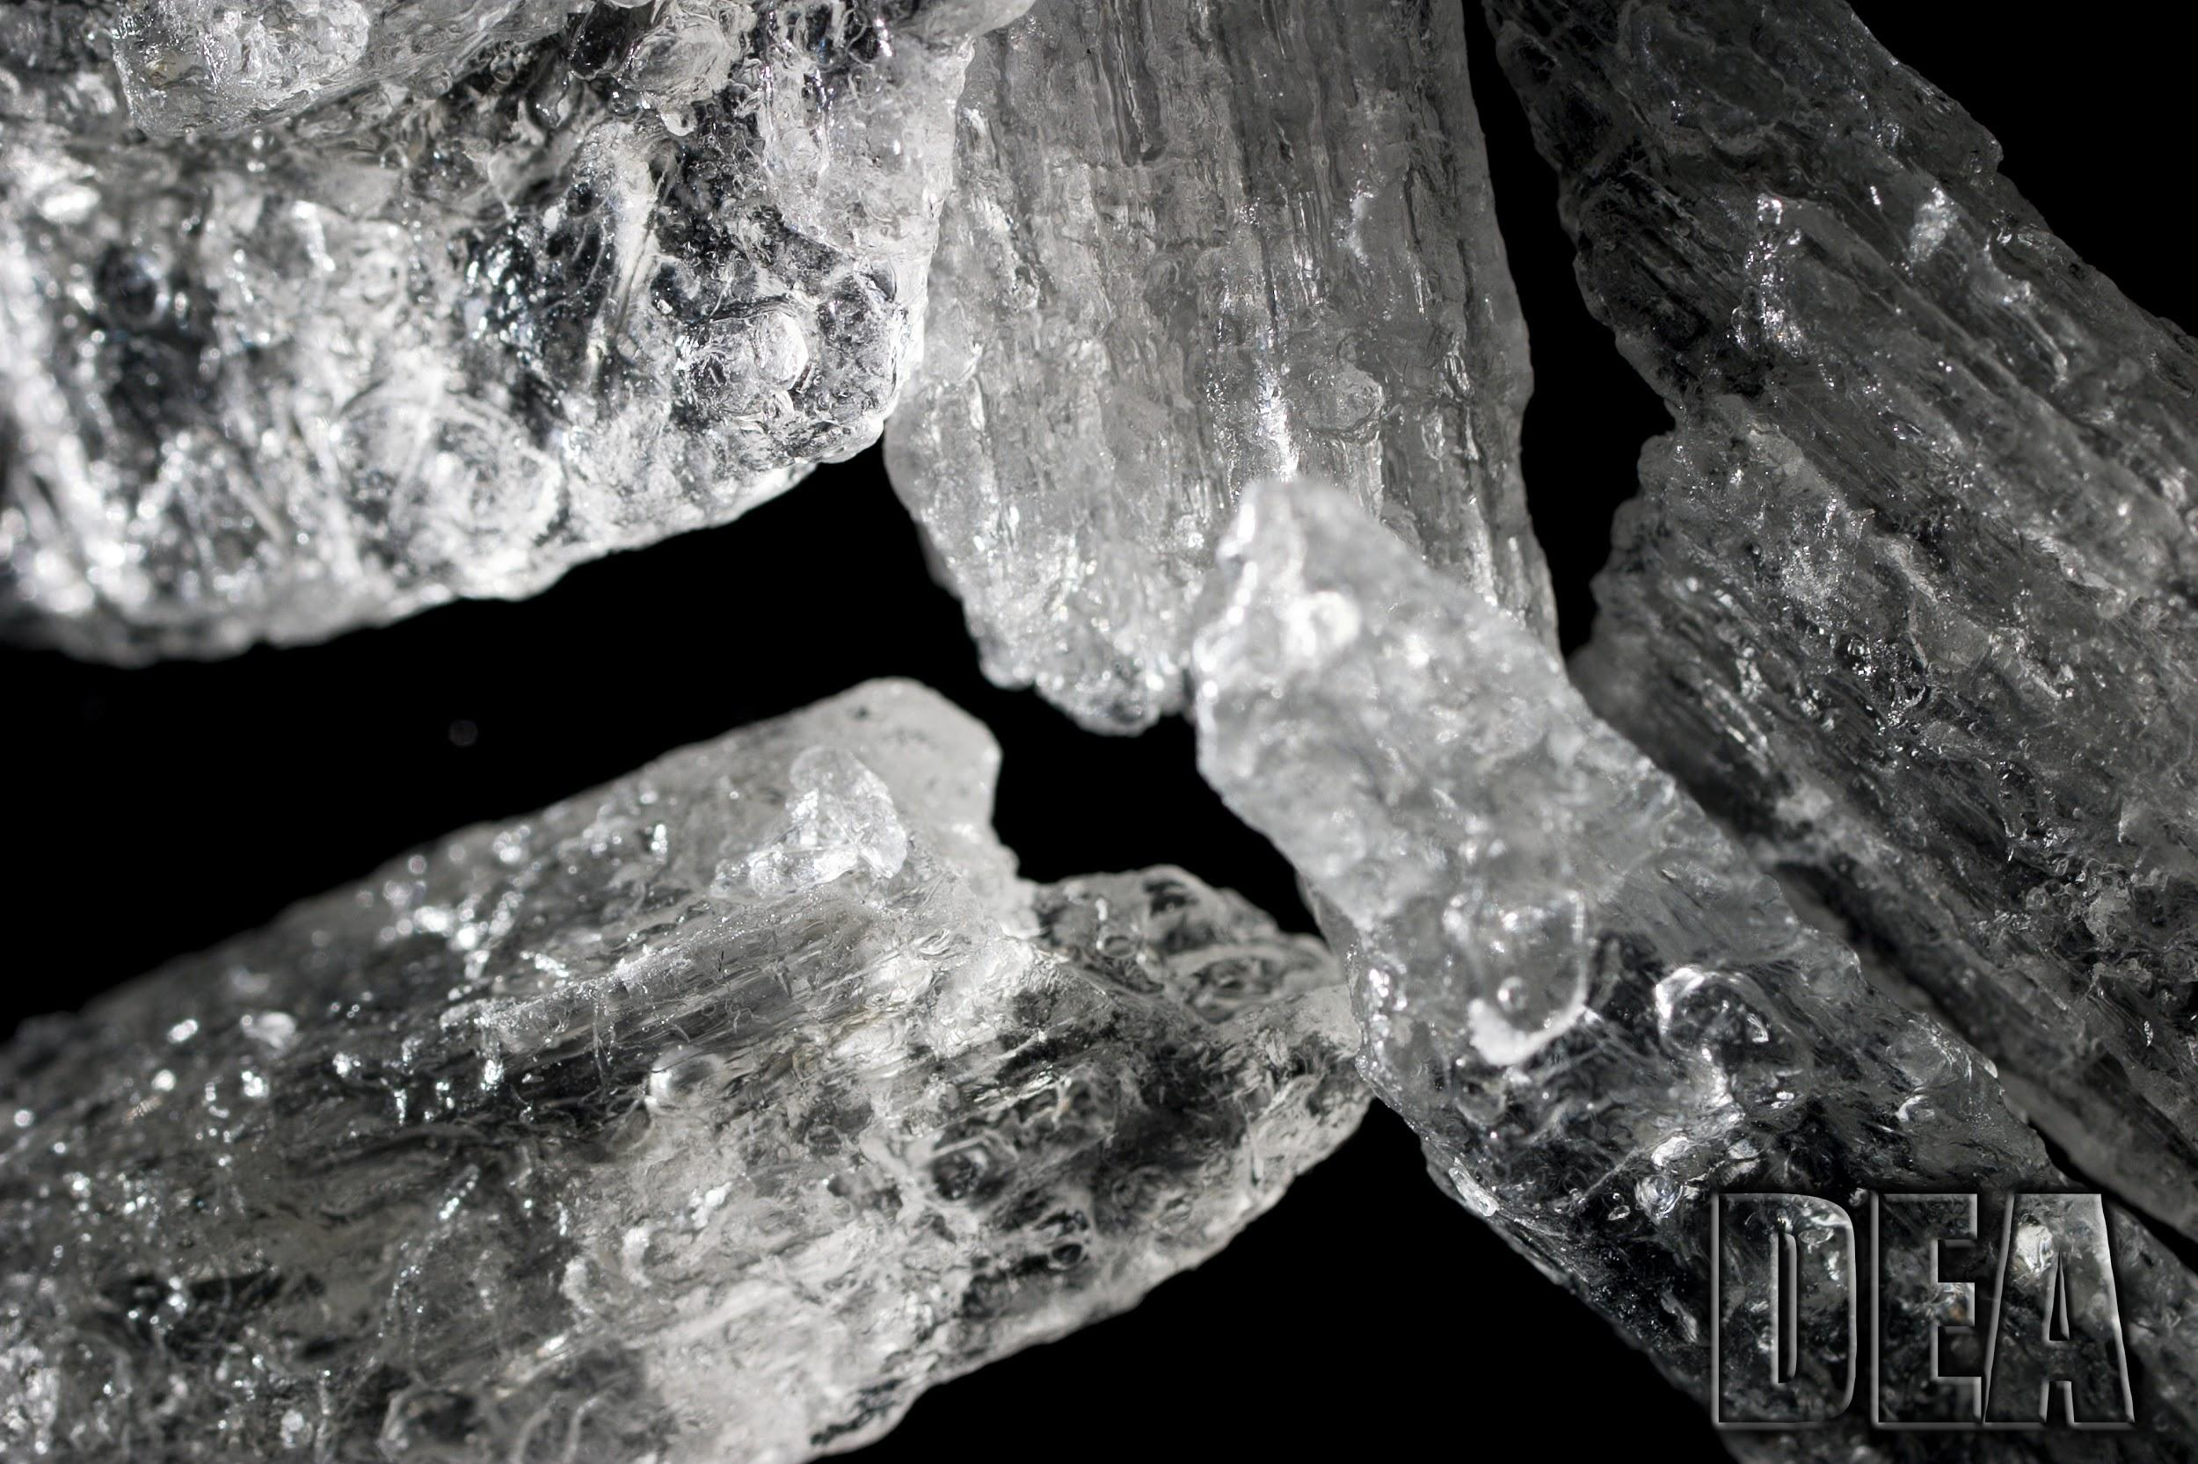
Methamphetamine
Rochelle Cudal
Daniella De La Torre

Slide 2
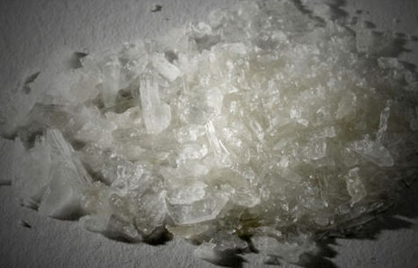
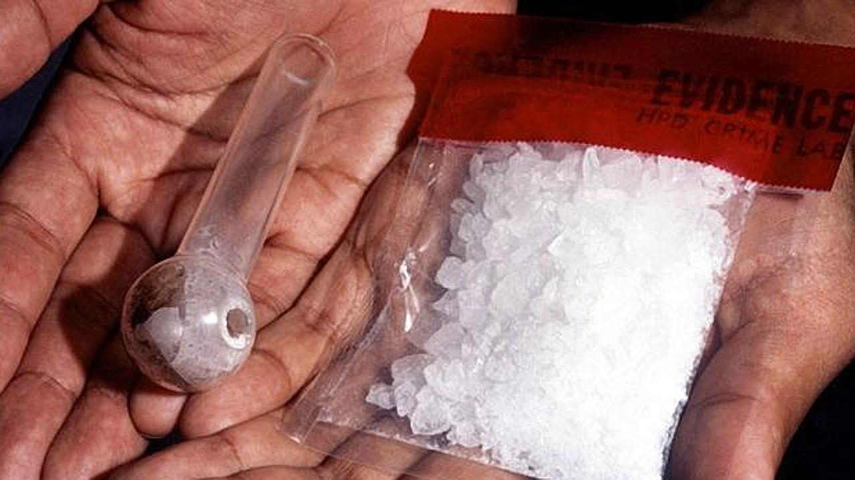
What Does This
Drug Look Like?
-White, odorless, bitter-tasting crystalline drug that people take.
-Can be smoked, injected or snorted.
-It's used in hollowed out ink pens and straws cut in half or thirds are used for snorting or smoking meth (Ferency).
Tweaking

Slide 3
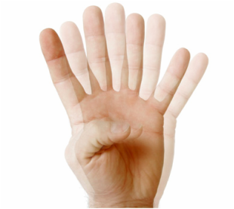
Short-Term Effects
Loss of appetite
Increased heart rate, blood pressure, body temperature
Dilation of pupils
Disturbed sleep patterns
Nausea
Bizarre, erratic, sometimes violent behavior
Hallucinations, hyperexcitability, irritability
Panic and psychosis
Convulsions, seizures and death from high doses
(Drug-Free World.)

Slide 4
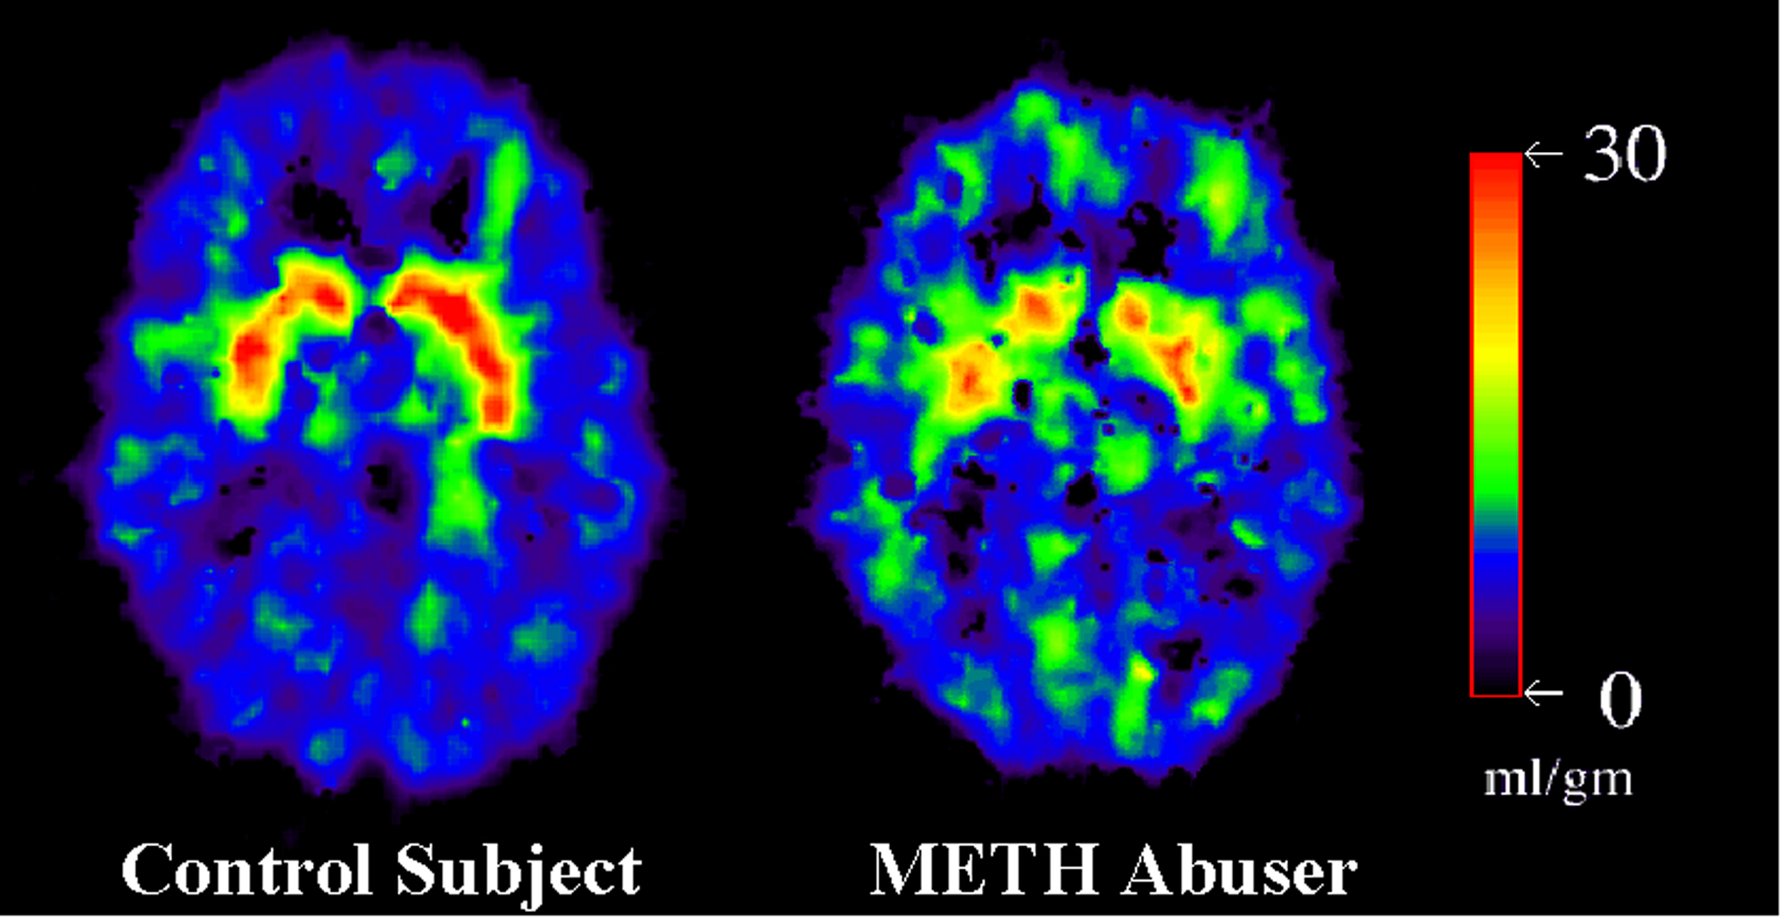
What Are The Long-Term Effects?
Permanent damage to blood vessels of heart and brain
Liver, Kidney and lung damage
Malnutrition, weight loss
Severe tooth decay
Disorientation, apathy, confused exhaustion
Psychosis
Depression
Brain Damage
(Drug-Free World.)
Notes:
Damage to the brain which leads to stroke. High blood pressure leading to heart attacks, strokes, or even death.

Slide 5
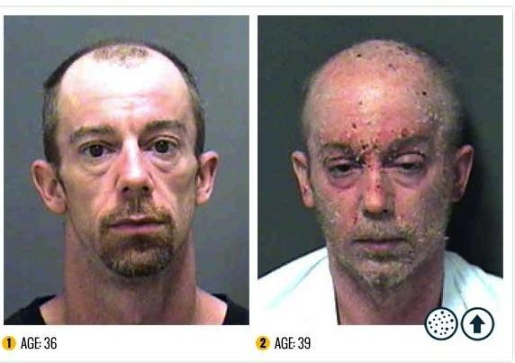
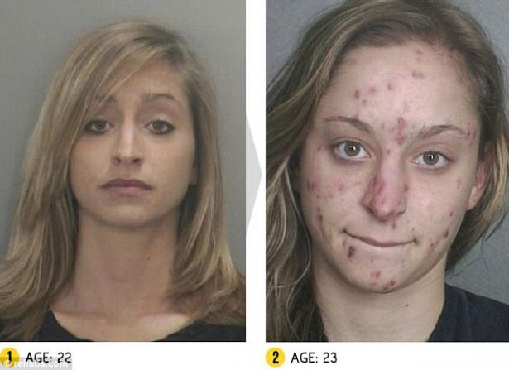
What Are The Long-Term Effects?
After 1 year of use
After 3 years of use
After 10 years of use

Slide 6
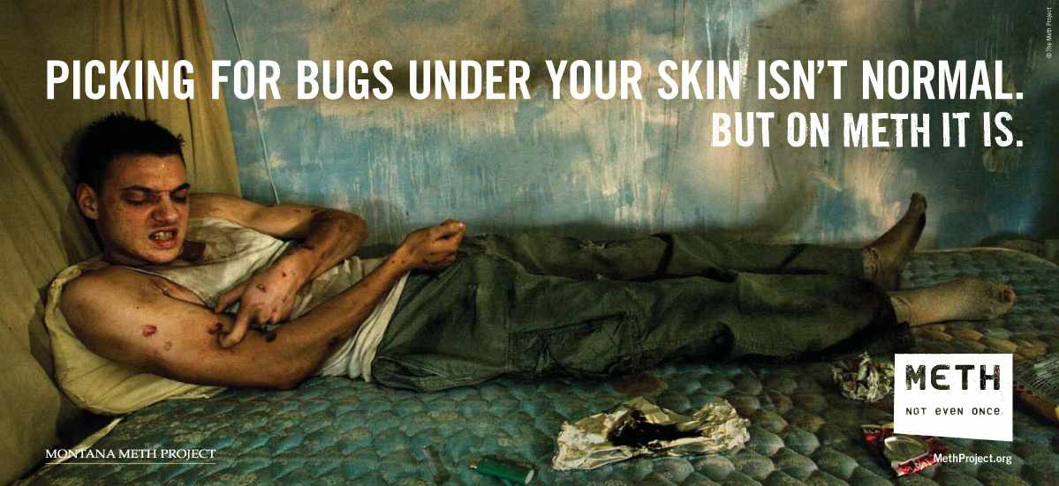
What are “Crank Bugs”?
Click here to find out
And here, too

Slide 7
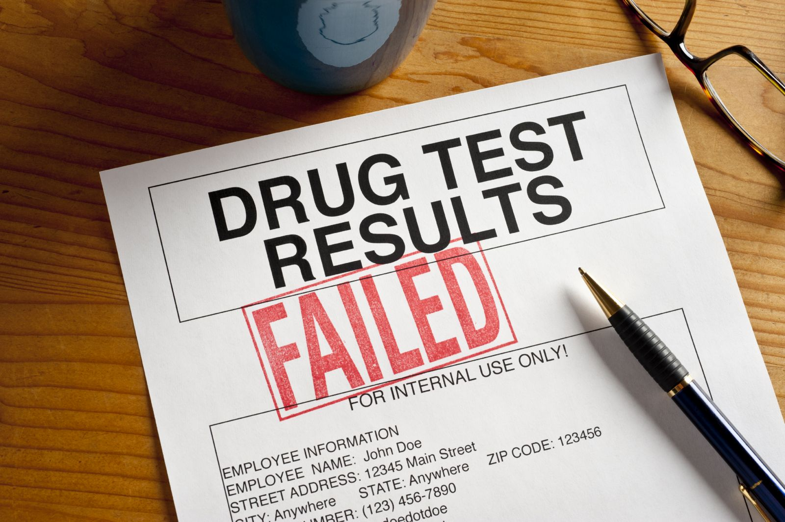
How Is The Drug Analyzed & Identified?
Tests & Results?
Meth can be found through almost any drug test ("Does Meth Show up on Drug Tests?")
A detection period depends on the drug class, amount and frequency of use, age, and overall health. For methamphetamine, the drug detection windows are
blood and oral fluid = detection period is within 12 hours of use
urine drug test = detection period is 3 to 5 days
hair follicle test = detection period is up to 90 days
Meth drug testing is a technical analysis of biological specimen done to detect the presence
of methamphetamine metabolites in the person’s body using the following samples:
blood
hair follicle
oral fluid (saliva)
urine

Slide 8
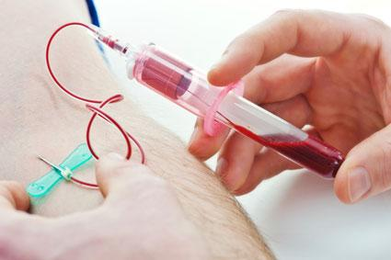
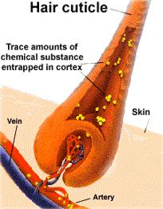
How Is The Drug Analyzed & Identified?
Tests & Results?
Blood tests for meth
This type of testing can link drug concentrations to behavioral impairment but is usually
limited to recent consumption and does not provide an accurate picture for past drug use.
Hair tests for meth
This type of testing can show evidence of past, historical use.
Detection window is limited to the amount of hair collected

Slide 9
How Is The Drug Analyzed & Identified?
Tests & Results?
Saliva testing for meth
Saliva drug tests is very useful for home use especially when parents suspect
their kids to have abused meth.
Saliva tests are accurate, easy to use, private and take only 5 minutes.
Detection times for drugs in oral fluids are approximately 1-24 hours. Oral
fluids normally contain traces of meth itself rather than its metabolites
(which are present in urine.)
Urine testing for meth
The drug testing methodology for urinalysis is well established.
Meth and it metabolites are detectable in urine for several days after the drug has been used.
While this detection window can overlap with intoxication, impairment,
and being “under the influence,” it cannot usually be used to prove intoxication in a legal sense.

Slide 10
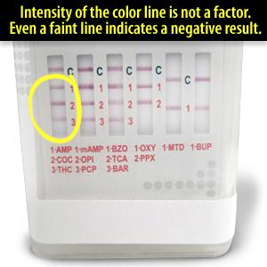
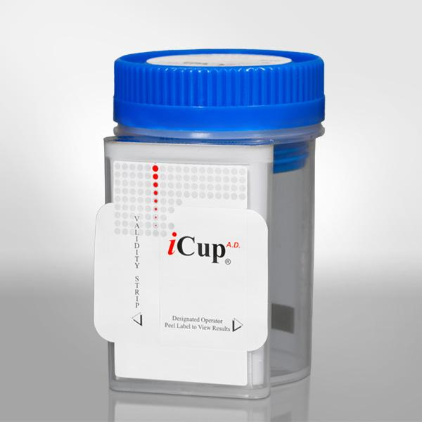
How Is The Drug Analyzed & Identified?
Tests & Results?

Slide 11
Penalty For Having This Drug In Your Possession
5 years for possession of any amount over 5 grams.
Maximum sentence of 40 years (Possession of Methamphetamine)
The penalties vary between state and national
Some states also offer drug courts and treatment centers.
Notes:
If convicted of possession of 50 grams or over, the mandatory minimum sentence is 10 years, and the maximum is life.

Slide 12
Celebrities Who Have Used Meth
Notes:
Amy Winehouse and Andy Irons (professional surfer) Andy Irons used too much meth & overdosed; they both died.

Slide 13
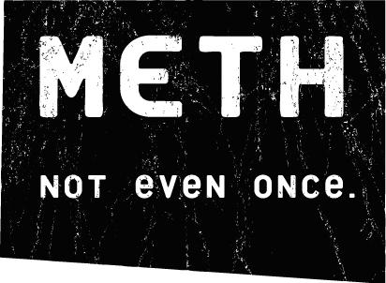
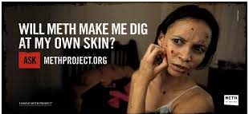
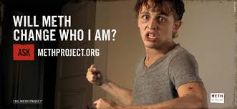
The Meth Project Foundation

Slide 14
Works Cited
"Alcohol and Drugs: Untimely Celebrity Deaths." Alcohol and Drugs: Untimely Celebrity Deaths. N.p., 15 Jan. 2016. Web. 20 Jan.
2016.
Ashley's Story. Meth Project Foundation, 2015. Online Short.
"Does Meth Show up on Drug Tests?" Drug.addictionblog.org. 24 Aug. 2014. Web. 19 Jan. 2016.
Ferency, Greg. "Recognizing Methamphetamine Use." PoliceLink. SWAT Digest, 2016. Web. 15 Jan. 2016.
Horton, John. "How To Read An ICup Drug Test." The Rapid Detect INC Blog. The RDI Blog, 27 May 2015. Web. 20 Jan. 2016.
"Possession of Methamphetamine." FreeAdvice. Advice Company, 1995-2016. Web. 17 Jan. 2016.
"Research Report Series: Methamphetamine Abuse and Addiction." HEALTH - Meth. ENDOWMENT FOR HUMAN
DEVELOPMENT, Jan. 2002. Web. 15 Jan. 2016.
"What Is Meth Made Of? How Is Crystal Methamphetamine Made? - Drug-Free World." What Is Meth Made Of? How Is Crystal
Methamphetamine Made? - Drug-Free World. Foundation for a Drug-Free World., 2006. Web. 17 Jan. 2016.

