Slide 1
Ecstasy
Ecstasy
Ecstasy
Created By:
Created By:
Bailey
Kaopuiki
Bailey
Kaopuiki
&
&
Zach
Anguay
Zach
Anguay

Slide 2
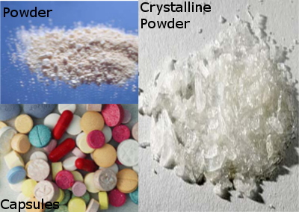
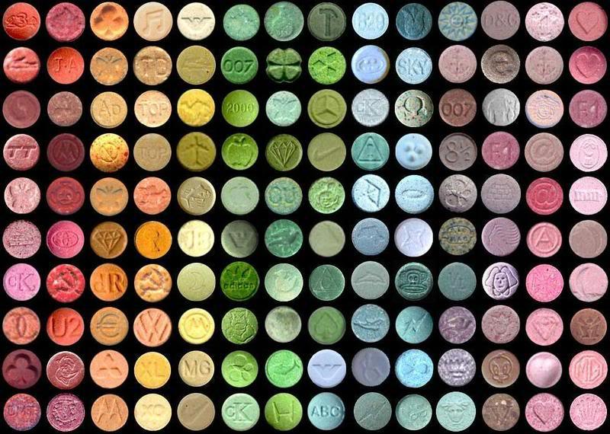
What Does The Drug Look Like?
ecstasy, is classified as a synthetic stimulant and hallucinogen. While pure MDMA is a white powder, most ingested ecstasy comes in a colorful pill form.
The pills normally have various names (Mitsubishi, Dolphin, Dove, etc) and stampings, which are intended to indicate the quality of the drug.

Slide 3
What Are The Short Term Effects
Impaired judgment
False sense of affection
Confusion
Depression
Sleep problems
Faintness and chills or swelling
Involuntary teeth clenching
Blurred vision
Nausea
Severe anxiety
Paranoia
Drug cravings
Muscle tension

Slide 4
What Are The Long Term Effects?
Long-lasting brain damage affecting thought and memory
Damage to portions of the brain that regulate critical functions such as learning, sleep and emotion
It is as if the brain switchboard was torn apart, then rewired backwards
Degenerated nerve branches and nerve endings
Depression, anxiety, memory loss
Kidney failure
Hemorrhaging
Psychosis
Cardiovascular collapse
Convulsions
Death

Slide 5
How It's Analyzed or Identified
The Marquis test is a reagent field test conducted by placing a drop of reagent liquid onto a small sample of the material being tested. The chemicals in the reagent react differently with different chemicals, turning a variety of colors based on the what is in the material being tested. A typical reaction to MDMA is dark purple / black. A bright orange reaction can indicate the presence of amphetamine or methamphetamine (speed).
The Simon's reagent field test is a two part test, a single drop of the first chemical is dripped onto the target substance and then the second chemical (baking soda water in this case) is dripped onto the substance and the color change occurs. Simon's Reagent should change to a dark blue if MDMA is present.

Slide 6
Ecstasy penalty
Possession of 5 grams or more of Ecstasy carries a lent alt of 5-40 years in prison. A person who is convicted with 50 grams or more of ecstasy may be sentenced of 10 years to life and/or be required to pay a fine of up to $4 million if the defendant is an individual or $10 million if the defendant is other than an individual.

Slide 7
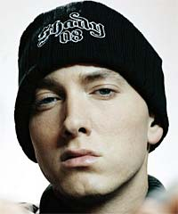
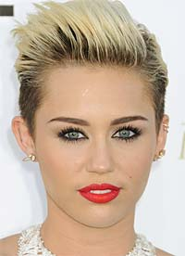
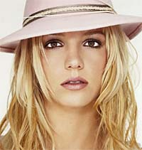
Quiz Yo
Q: Which one of these famous celebrities had used Ecstasy?
Eminem
Miley Cyrus
Britney Spears

Slide 8
ANSWER: ALL OF THEM HAD USED ECSTASY!

Slide 9
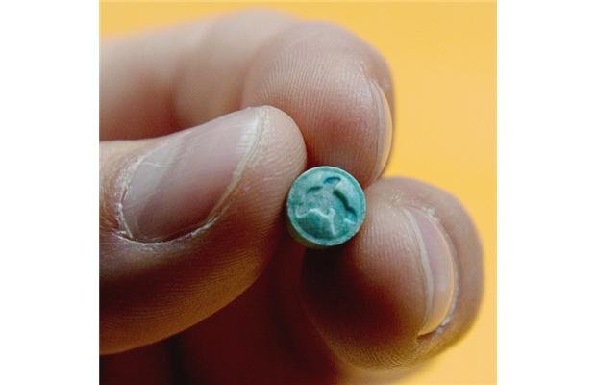
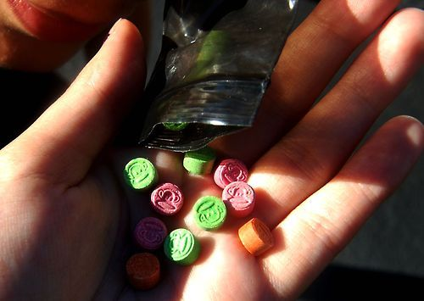
Scenario: You go to a college party and a stranger offers you candy or ecstasy, which one would you choose?
RULES: YOU HAVE TO CHOOSE 1!!
RAISE LEFT HAND FOR THIS ONE
RAISE RIGHT HAND FOR THIS ONE

Slide 10
FOR THOSE WHO RAISED THEIR RIGHT HAND: If you decided to choose the right unfortunately you chose the Ecstasy.
----STORYLINE STORY FOR YOUR DECISION---------
You start to feel different but it doesn't really phase you so you grab a beer. Next you get drunk and and you see more Ecstasy on the table you take one, next you take two, now it went up to 10. You just overdosed on Ecstasy and died. Congratulations!

Slide 11
FOR THOSE WHO RAISED THEIR LEFT HAND: if you decide to chose the left, congratulations you did the right thing to do!
----STORYLINE STORY FOR YOUR DECISION---------
BUT, even though you chose candy over ecstasy the “stranger” actually gave you ecstasy, you chose to drink alcohol during the party and then the ecstasy and alcohol mixed. Unfortunately mixing alcohol and Ecstasy can lead to heart failure. So you have also died. Congratulations!
(MORAL OF THE STORY)

Slide 12
Cited Sources
The Atlantic. Atlantic Media Company, n.d. Web. 19 Jan. 2016.
"Ecstasy - Partnership for Drug-Free Kids." Partnership for Drug-Free Kids. N.p., n.d. Web. 19 Jan. 2016.
"Ecstasy." Ecstasy. N.p., n.d. Web. 19 Jan. 2016.
"Information About Ecstasy Pills - What Is the Drug MDMA? Drug-Free World." Information About Ecstasy Pills - What Is the Drug MDMA? Drug-Free World. N.p., n.d. Web. 19 Jan. 2016.
"MDMA - Above the Influence." Above the Influence. N.p., n.d. Web. 19 Jan. 2016.
"MDMA (Ecstasy or Molly)." DrugFacts:. N.p., n.d. Web. 19 Jan. 2016.
"What You Need to Know About Drugs: Ecstasy." KidsHealth - the Web's Most Visited Site about Children's Health. Ed. Mary L. Gavin. The Nemours Foundation, 01 Jan. 2014. Web. 19 Jan. 2016.

