Slide 1
Collect 3 sheets of paper and layer them about 1.5 cm apart vertically. Keep the edges level.
Fold up the bottom edges of the paper to form 6 equal tabs.

Slide 2
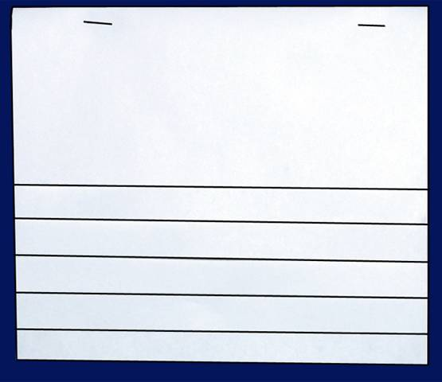
Fold the papers and crease well to hold the tabs in place. Staple along the fold.
Label each tab as shown.
From DNA to Protein
Your Name
Transcription
RNA Processing & the Genetic Code
Translation
Translation cont.

Slide 3
Complete the inside of the first page as follows: begin on page 288 of you textbook
Part I
Part 2
Picture and description of
Where Transcription
Takes place
Description of the 3 differences between DNA
And RNA
Part 3
Draw a picture of Transcription occurring and explain the importance of transcription
Transcription

Slide 4
Explain the roll of each of the following words in Protein Synthesis
Nucleus:
Ribosome:
The Nitorgen Base Uracil:
Codon:
RNA Processing & the Genetic Code

Slide 5
Complete the top of the third page as follows:
In this space, describe the role and function of transfer RNA (tRNA)
Detailed drawing of tRNA molecule
Translation
Detailed drawing of the process of Translation
Description of the difference between transcription and Translation

Slide 6
Compile a picture showing the entire processes of transcription & Translation
Things to include in your picture:
Nucleus
DNA Double Helix
Copying of DNA->mRNA
Ribosomes
mRNA -> tRNA
Codons
Amino Acids
Protein
Protein Synthesis

Slide 7
Complete the bottom of the forth page as follows:
Using your textbook and 11.1 on page 292, complete the data table for MiniLab 11.1 on page 293.
 | A | B | C | D | E
DNA Base Sequence | Process | mRNA Codon | Process | mRNA Anticodon | Amino Acid
TAC
AAT
GGG
ATA
AAA
GTT
ACT
Translation cont.

