Slide 1
Cannabis
T-dawgg & Niggi

Slide 2
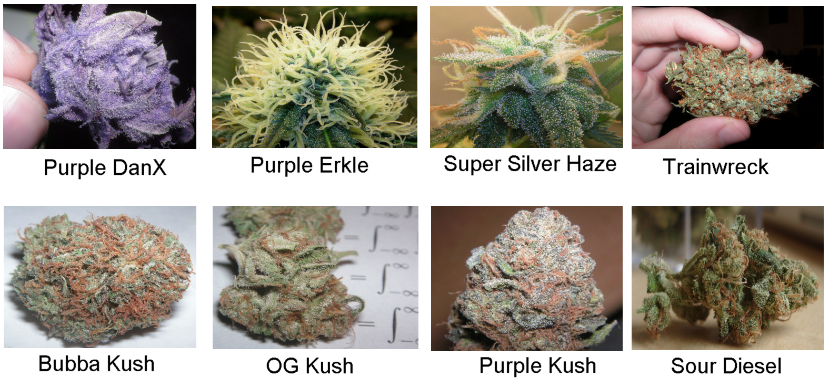
What does Marijuana look like?
It’s most common form is dried leaves that are green to brown.They can be whole leaves and buds or cut up.

Slide 3
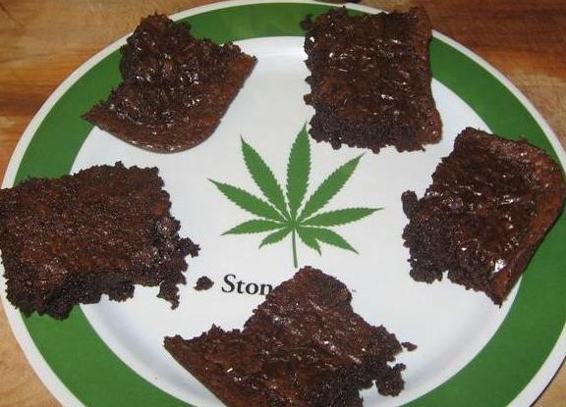
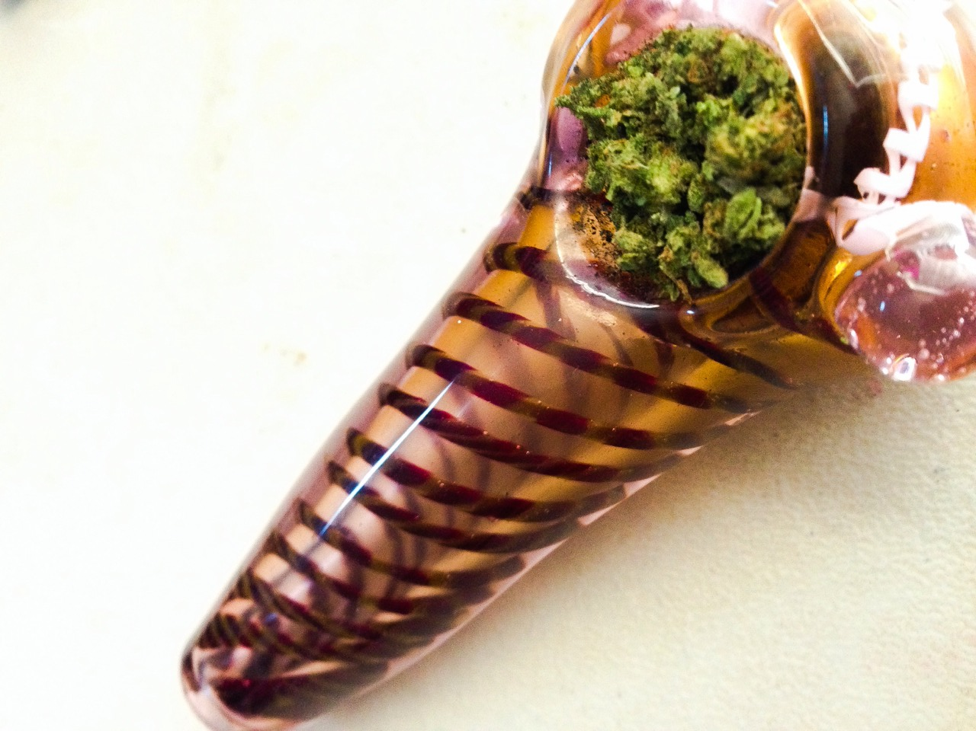
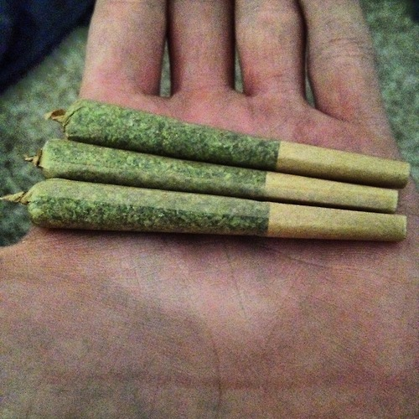
How ganja is ingested
Marijuana can be ingested by smoking or by eating it. It can be smoked using hand-rolled cigarettes (joints), in pipes or water pipes (bongs), blunts—emptied cigars that have been partly or completely refilled with marijuana, and vaporizers. Marijuana users put weed in food called edibles, such as brownies, cookies, candies, or even brewed into tea.

Slide 4
Short Term Effects
How Does It Affect The Body?
Poor reaction time
Impaired vision
Impaired memory
Change in mood
Short attention span
Crave food
Depression
Hallucinations
When a person intakes the drug, THC passes the lungs into the bloodstream. The blood carries the chemical to the brain and other organs throughout the body.
THC acts on specific brain cell receptors that ordinarily react to natural THC-like chemicals in the brain. These natural chemicals play a role in normal brain development and function.

Slide 5
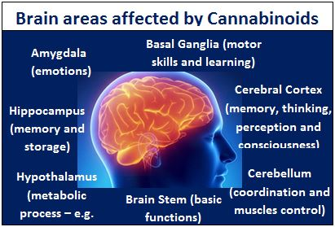
Long Term Effects
For teenagers, the drug may reduce thinking, memory, and learning functions and affect how the brain builds connections between the areas necessary for these functions.
Affects the Immune system. The THC in marijuana can damage the cells and tissues in the body that help protect against disease.
Reproductive hormones are decreased. In men, there is less testosterone, causing decreased sperm counts and possible erectile dysfunction. In women, there may be irregular periods. Both problems would result in a decreased ability to conceive but not lead to complete infertility.

Slide 6
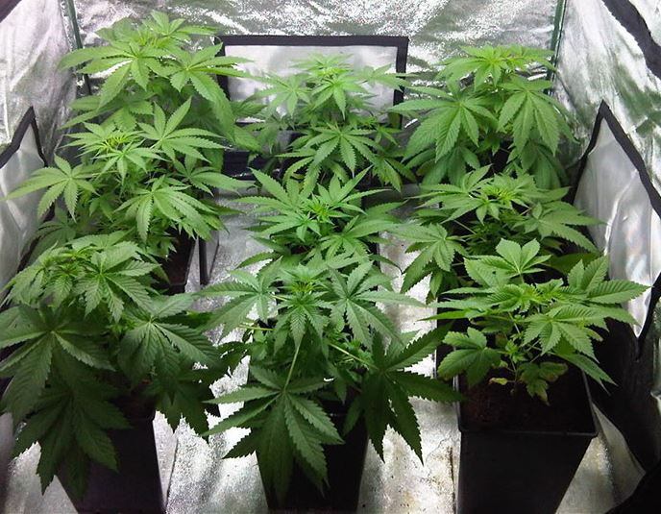
How Is Pakalolo Made?
Cannabis is used in three main forms: marijuana, hashish and hash oil. Marijuana is made from dried flowers and leaves of the cannabis plant. It is the least potent of all the cannabis products and is usually smoked or made into edible products like cookies or brownies . Hashish is made from the resin of the cannabis plant. It is dried and pressed into small blocks and smoked. It can also be added to food and eaten. Hash oil, the most potent cannabis product, is a thick oil obtained from hashish. It is also smoked.

Slide 7
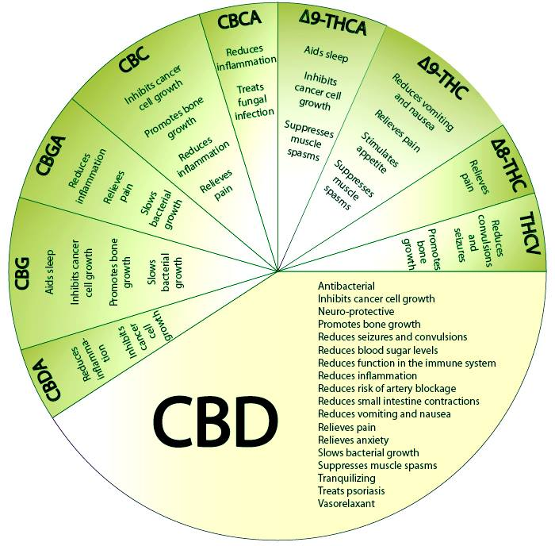
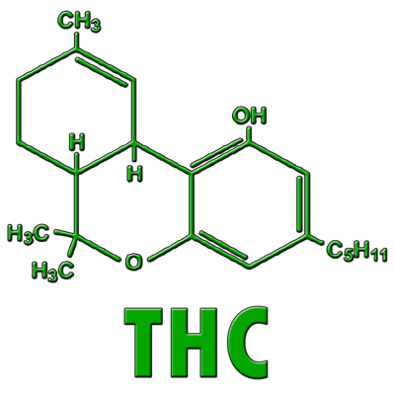
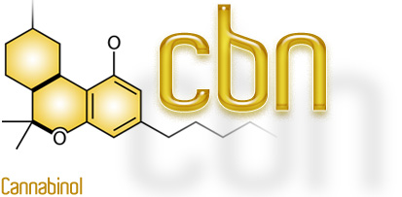
What chemicals are in marijuana?
There are 483 different chemicals in cannabis.
THC- The one that gets one high.
CBD- Used to help with acne, ADD, anxiety, arthritis,cancer, etc...
CBN- creates mild psychoactive effects.
CBC- It Contributes to the overall analgesic effects of medical cannabis.

Slide 8
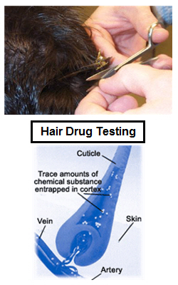
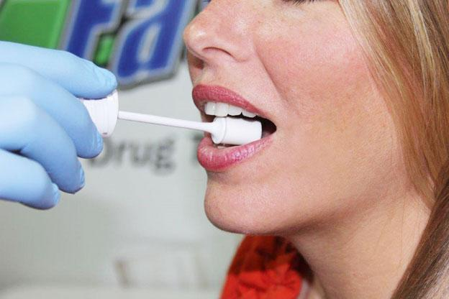
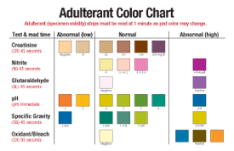
FOrensic Technology
A person who is alive…
Urine test
Blood test
Hair test
Saliva test
A person who is dead…
-The best bet would
be to do the hair test.

Slide 9
Consequences of being in possession of Marijuana
In Hawaii being in possession of less than 1 oz is a misdemeanor and will get you 30 days in jail plus a $1,000 fine, 1oz-1lb is a misdemeanor and will get you 1 year in jail plus a $2,000 fine, and 1lb or more is a felony and will get you 5 years in jail plus a $10,000 fine.
Legalization. In five states -- Alaska, Colorado, Washington D.C., Oregon, and Washington -- possession by adults of small amounts for personal use is completely legal under state law.
Decriminalization. Other states have classified possession of small amounts as an infraction, including California, Connecticut, Maine, Massachusetts, Minnesota, Mississippi, Nebraska, Nevada, New York, North Carolina, and Ohio. An infraction is a minor violation akin to a traffic ticket; typically, violators are subject only to a small fine and first time offenders usually have no criminal record. In states that have decriminalized marijuana, offenders receive citations but they are not arrested unless they possess large amounts or are repeat offenders.

Slide 10
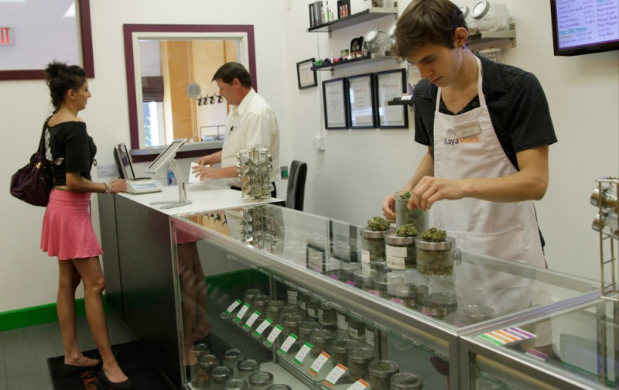
Oregon Marijuana Laws
The new law, called Measure 91, takes effect on July 1, 2015, although sales will not be legal until 2016. The new Oregon law legalizes the possession of marijuana by adults age 21 and over for personal, nonmedical use. Oregon already had in place a medical marijuana law that allowed use for certified medical purposes. Measure 91 has no effect on Oregon’s medical marijuana laws and, even after personal use is allowed, Oregonians without medical certification will not be able to purchase marijuana for personal use at medical marijuana dispensaries. Measure 91 also legalizes commercial grow and retail operations, and sets up a procedure to regulate and tax such operations.
Budtenders at the medical marijuana dispensary Kaya Shack helps a customer choose her products, in Portland, Oregon.

Slide 11
Work Cited
Barnard, Jeff. "Oregon Opens Door to Legal Pot; Retail Sales Still in Works." The Cannabist. N.p., 01 July 2015. Web. 20 Jan. 2016."
Oregon Marijuana Laws." CriminalDefenseLawyer.com. N.p., n.d. Web. 20 Jan. 2016.
"Marijuana Drug Test Detection Times." Marijuana Drug Test Detection Times. N.p., Aug. 2012. Web. 20 Jan. 2016.
"Reforming Marijuana Laws." Hawaii Laws & Penalties. NORML Foundation, 2016. Web. 19 Jan. 2016.
"THC, THCA, CBD, CBC, CBN: Some of the Chemicals in Cannabis."UnitedPatientsGroupcom Blog. United Patients Group, 11 Apr. 2014. Web. 20 Jan. 2016.

