Slide 1
The Origin of Species
Chapter 24

Slide 2
You Must Know:
•The biological concept of speciation
•Prezygotic and postzygotic barriers that maintain reproductive isolation in natural populations
•A description of similar species that are maintained separate by each type of isolating barrier
•How allopatric and sympatric speciation are similar and different
•How a change in chromosome number can lead to sympatric speciation
•Why speciation rates are often rapid in situations when adaptive radiation occurs or during times of ecological stress
•The connection between a change in gene frequency, a change in the environment, natural selection or genetic drift and speciation
•How punctuated equilibrium and gradualism describe two different tempos of speciation

Slide 3
24.1: The biological species concept emphasizes reproductive isolation
Speciation: The process by which new _________ arise.
Microevolution & Macroevolution:
Microevolution: Change in the __________ makeup of a population from generation to generation; Adaptations that are confined to a single gene pool.
Macroevolution: Evolutionary change above the species level.
Biological Species Concept: Defines a species as a group of populations whose members have the potential to ____________ in nature and produce _______, ________ offspring but are unable to produce viable, fertile offspring with members of other groups.
species
genetic
interbreed
viable
fertile

Slide 4
24.1: The biological species concept emphasizes reproductive isolation
_________________ Isolation: Existence of biological barriers that impede members of two species from producing viable, fertile offspring.
Prezygotic & Postzygotic Barriers: Prevent members of different species from producing fertile offspring
_____________ Barriers: Prevent mating or hinder fertilization if mating has occurred
Examples: Habitat isolation, behavioral isolation, temporal isolation, mechanical isolation, gametic isolation
______________ Barriers: Prevent a hybrid zygote from developing into a fertile adult
Examples: Reduced hybrid viability, reduced hybrid fertility, hybrid breakdown.
Reproductive
Prezygotic
Postzygotic

Slide 5
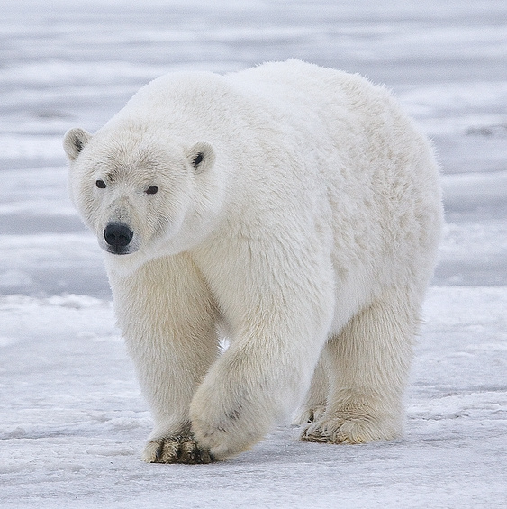
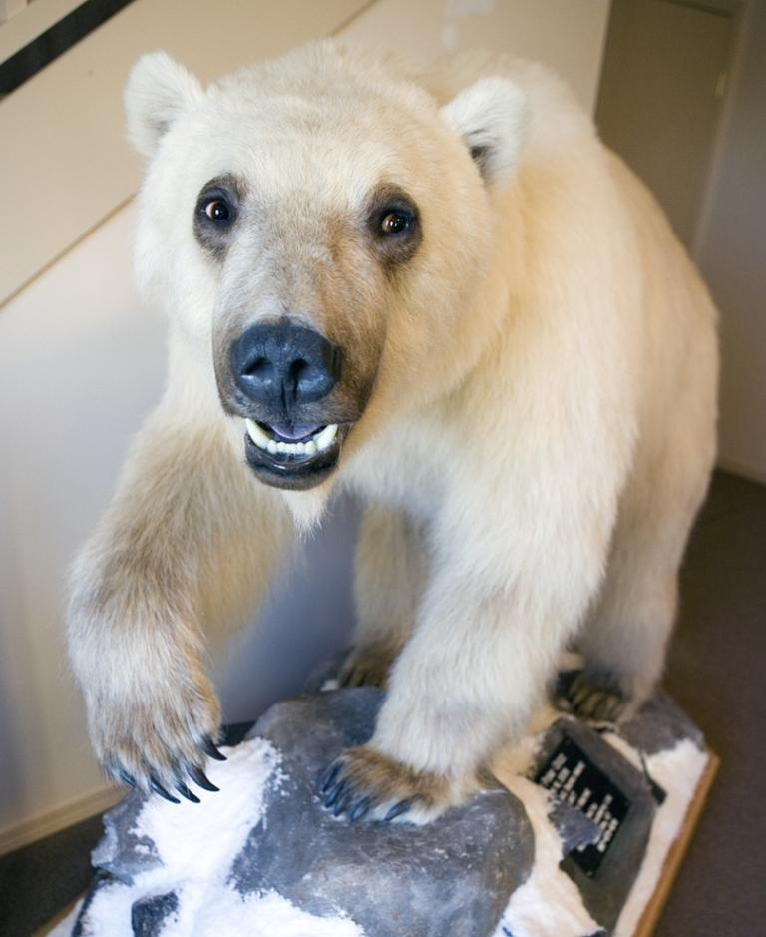
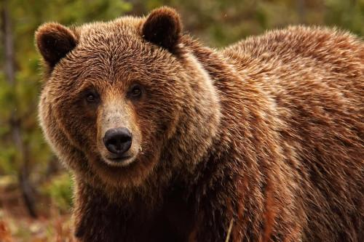
24.1: Additional Vocabulary
Hybrid: offspring that result from an interspecific mating
Morphological Species Concept: characterizes species by body shape and other structural features
Ecological Species Concept: views a species in terms of its ecological niche
Phylogenetic Species Concept: defines a species as the smallest group of individuals that share a common ancestor
Grizzly bear (Ursus arctos)
Hybrid
“grolar bear”
Polar bear (Ursus maritimus)

Slide 6
24.2: Speciation can take place with or without geographic isolation
speciation is gene flow interrupted when a population is divided into geographically isolated subpopulations.
Occurs when of the two species diverge because mutations arise, natural selection may occur, and genetic drift may alter allele frequencies.
Allopatric
gene pool

Slide 7
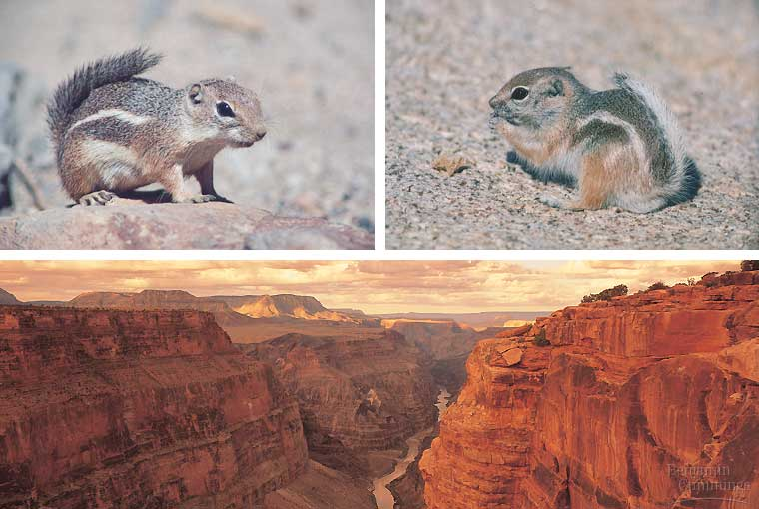
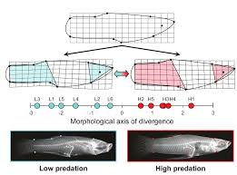
24.2: Speciation can take place with or without geographic isolation
For example: Antelope squirrels on opposite rims of the Grand Canyon.
For example: Mosquitofish in the Bahamas colonize a series of ponds that are isolated from each other.

Slide 8
24.2: Speciation can take place with or without geographic isolation
speciation is when a small part of a population forms new species without being geographically separated from the parent population.
Sympatric speciation is possible when ,
,or occurs
Sympatric
polyploidy
sexual selection
habitat differentiation

Slide 9
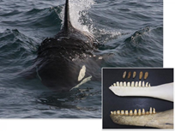
24.2: Speciation can take place with or without geographic isolation
For example: Divergence of "resident" and "transient" Orca forms in the northeast Pacific.

Slide 10
24.2: Speciation can take place with or without geographic isolation
Polyploidy- species having more than ______ complete chromosome sets
______% of plant species were involved in polyploidy events
two
80

Slide 11
24.2: Speciation can take place with or without geographic isolation
Adaptive radiation- occurs when many new species descended from a ____________ ___________.
New species fill different ecological niches in their communities.
Catastrophes such as volcanoes, landslides, or mass extinctions open new _________.
common ancestor
niches

Slide 12
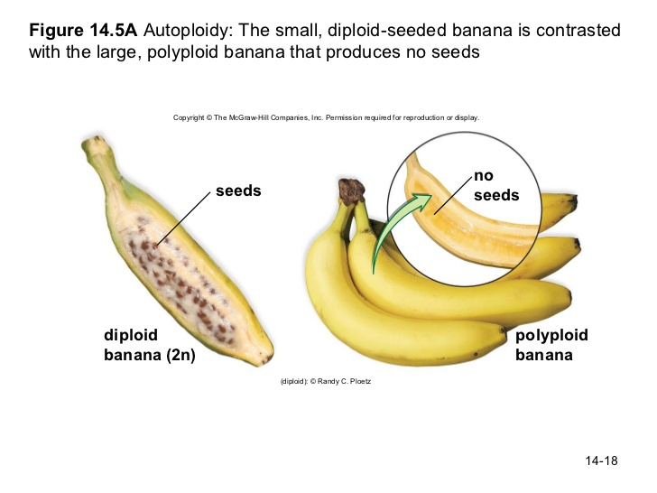
24.2: Speciation can take place with or without geographic isolation
Other Vocabulary
Autopolyploidy: more than two sets of chromosomes; caused by meiotic failure in self-pollinating plants

Slide 13
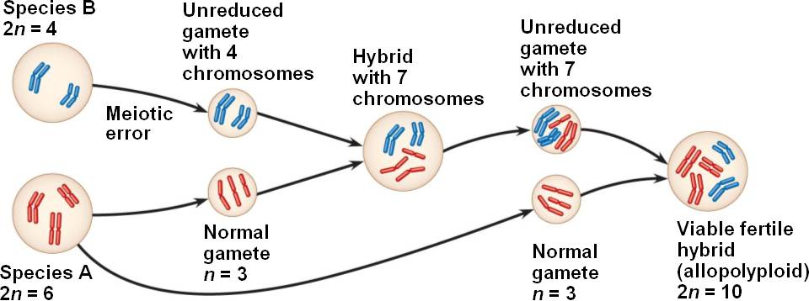
24.2: Speciation can take place with or without geographic isolation
Other Vocabulary
Allopolyploidy: interspecific hybrid that is fertile due to nondisjunction (more common)

Slide 14
24.3: Patterns within hybrid zones
What is a hybrid zone?
The frequency of the alleles are typically _______ at the center of hybrid zones.
Patterns in hybrid zones are caused by an obstacle in __________.
Because the hybrids have poor survival and reproduction, they produce ____ viable offspring. The toads have an increased rate of embryonic mortality and morphological abnormalities.
A region in which members of different species meet and mate, producing at least some offspring of mixed ancestry.
equal
gene flow
few

Slide 15
24.3: Patterns within hybrid zones
As a result, hybrids _____ serve as a stepping-stone from which alleles are passed from one species to the other.
Hybrid zones may have more complicated spatial patterns. For example, plants grow in favorable patches. These plants may interbreed, causing a complex hybrid zone consisting of disconnected patches.
rarely

Slide 16
24.3: Hybrid zones over time
Hybrids may become reproductively isolated from their parents and create a new species.
Three possible outcomes for the hybrid zone over time: _________________________, _________________, and _________.
reinforcement of barriers
fusion of species
stability

Slide 17
24.3: Hybrid zones over time
Reinforcement: Natural selection strengthens prezygotic barriers to reproduction, thus reducing the formation of unfit hybrids. It reinforces reproductive barriers.
Fusion: If two species make contact in a hybrid zone, but the barriers to reproduction are not strong, gene flow may cause reproductive barriers may weaken and they will become increasingly alike. The speciation process would reverse, eventually causing the two hybridizing species to fuse into a single species.
Stability: Many hybrids continue to be produced and some hybrids reproduce better than their parent species, creating stability.

Slide 18
24.4: Speciation can occur rapidly or slowly, and it can result from changes in few or many genes
Information about how long it takes for a new species to be formed may be gathered from _______________ and from studies that use morphological data or molecular data to asses the time intervals between speciation events in groups of organisms.
Fossil records include many episodes in which new species appear suddenly in a geologic stratum, persist essentially through several strata, and then disappear. _________________________ describes these periods of apparent stasis punctuated by sudden change.
fossil records
Punctuated equilibria

Slide 19
Punctuated VS. Gradual
Other species however change ____________ over long periods of time.
gradually

Slide 20
Studying the Genetics of Speciation
The punctuated pattern suggests that once the process of speciation begins, it can be completed ___________. This information suggests that new species can arise once ______________ begins.
Speciation only begin after _____________ between populations is interrupted by change in environmental conditions, or by unpredictable events. In a few cases, the evolution of reproductive isolation is due to a change in a _________ gene.
rapidly
divergence
gene flow
single

Slide 21
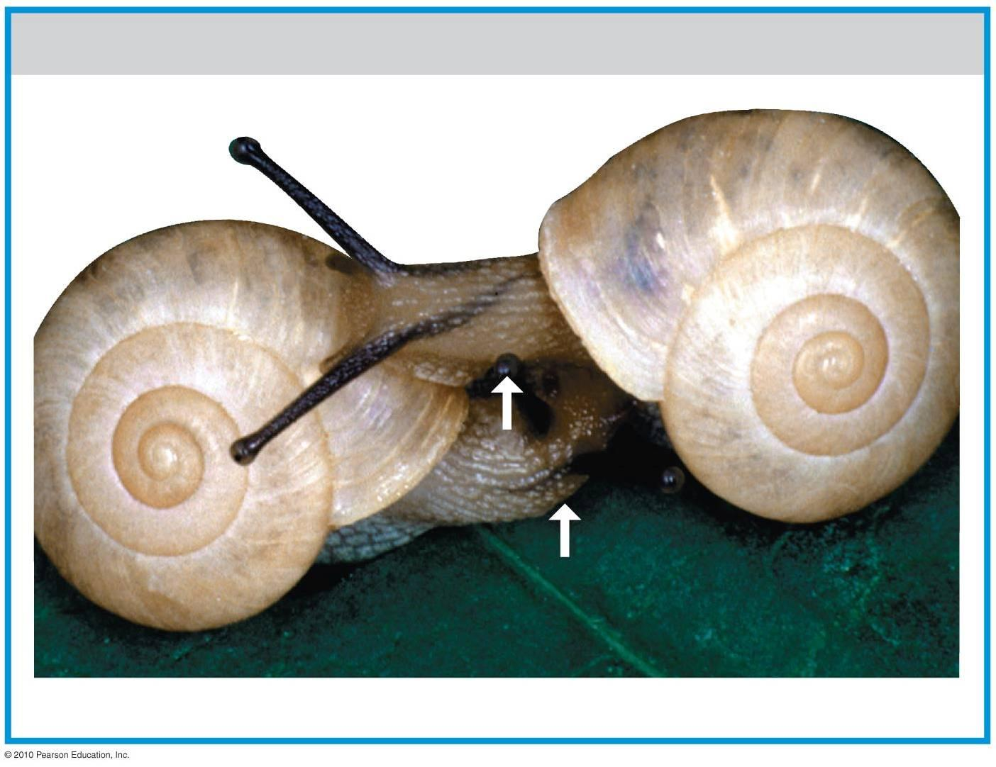
In Japanese land snails from the genus Euhadra, the alleles of a single gene controlling the direction of shell spirals can induce a _____________ barrier to reproduction.
mechanical

Slide 22
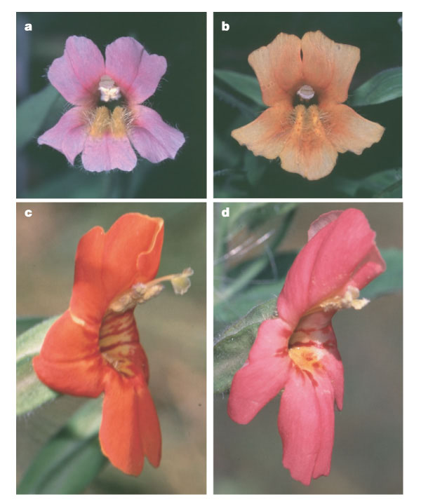
A major reproductive barrier between two closely related species of monkey flower Mimulus cardinalis and M. lewisii, also appears to be influenced by a relatively small number of genes. These two species are isolated by several _____________ and _____________ barriers.
prezygotic
postzygotic

Slide 23
In other cases, speciation may be influenced by _________ numbers of genes and gene interactions. Hybrid sterility between two subspecies of Drosophila pseudoobscura results from gene interactions at two loci. Few or many genes can influence the evolution of ____________________________ and speciation.
Although the changes after any speciation event may be subtle, the cumulative change over millions of speciation episodes leads to the formation of new groups of organisms that differ significantly from their ______________.
larger
reproductive isolation
ancestors

