Slide 1
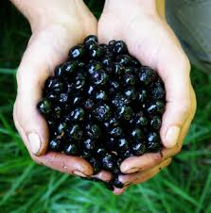
BellaDonna
Shanelle Macaraeg and Zoe Langseth

Slide 2
basic info
Hallucinogenic that comes from a plant
One of the most toxic plants in the Eastern Hemisphere.
2-5 berries can be fatal
1 leaf is fatal
Blocks the functions of the body’s nervous system
Other names include, Deadly Nightshade, Devil’s Berries, and Naughty Mans Cherries.
Part of the potato family

Slide 3
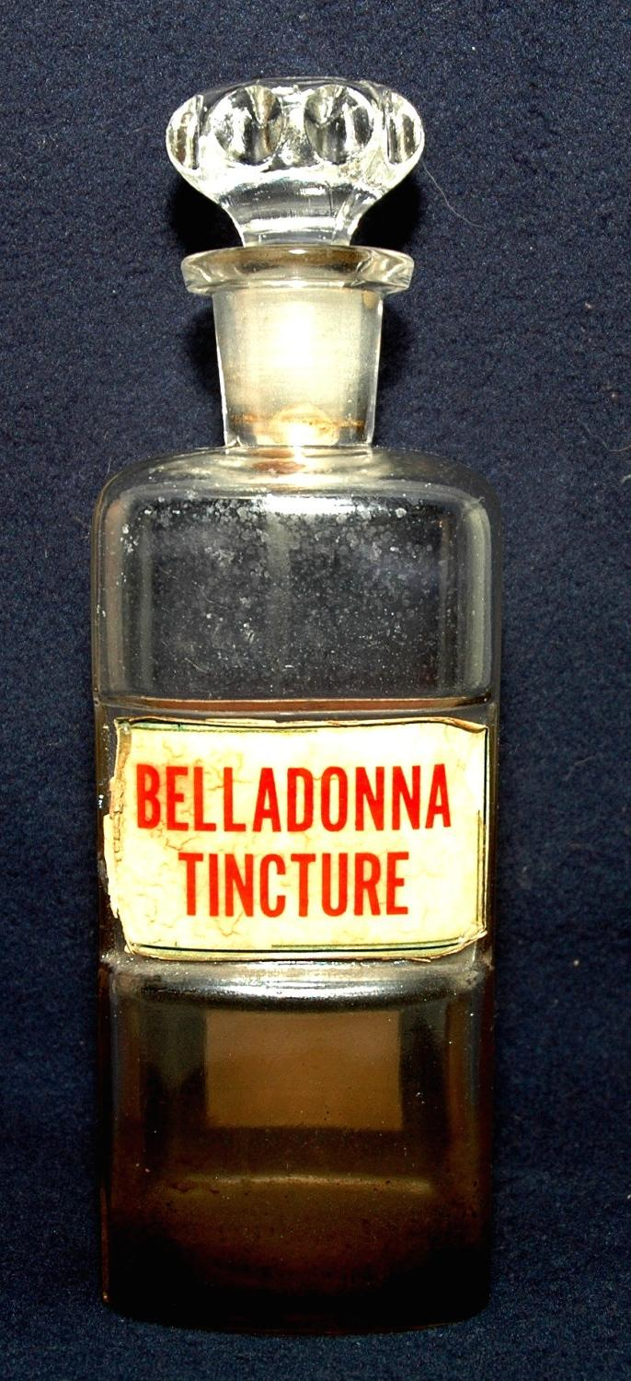
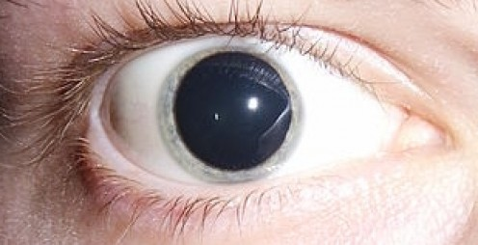
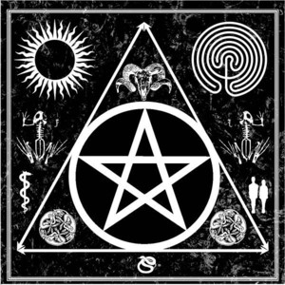
History of Belladonna
In Italian Belladonna means Beautiful Lady
In Italy, Belladonna juice was used to enlarge pupils in women, to enhance appearances and appear more seductive.
In the Medieval times, the plant was used in witchcraft and devil worship.

Slide 4
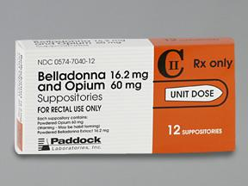
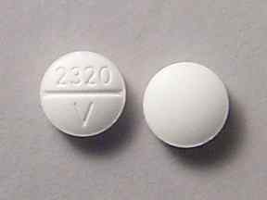
Medical Uses
Used as a sedative to stop Bronchial spasms in Asthma and Whooping Cough
Cold and Hayfever remedy
Parkinson’s disease, colic, motion sickness, and as a painkiller
Used in ointments
Hemorrhoid suppositories
Treats psychiatric disorders
Often paired with Opium

Slide 5
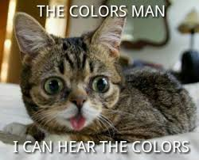
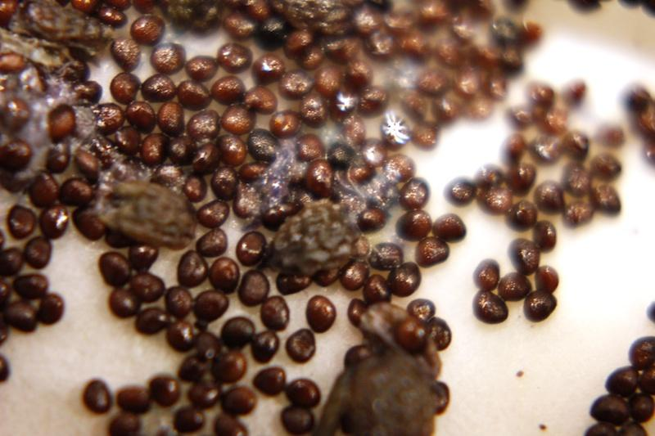
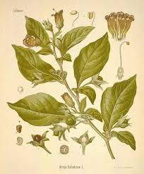
How To Consume Belladonna
Boil leaves into a tea
Consuming the seeds
Eating the berries
Straight up eating the leaves.

Slide 6
Laws
United States does not regulate the plant (Excluding Louisiana and Tennessee)
Perfectly legal
Buy and sell without a licence or prescription
If made for supplement must follow U.S. laws
If consumed must pass FDA laws
Available on Amazon for ~ 15$ including shipping.

Slide 7
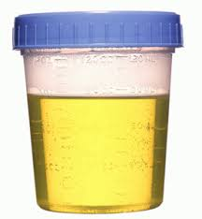
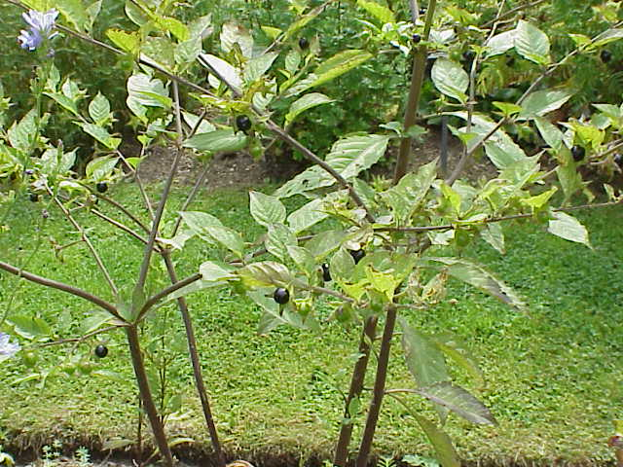
how to find
Analyzed through toxicology report
Can be found in Urine, Plasma
Dilation of pupils

Slide 8
short term effects
Light Sensitivity
Blurred Vision
Loss of Balance
Headache
Rash Constipation
Hallucinations
Delirium
Convulsions

Slide 9
long term effect

Slide 10
First Hand Experiences!!!!!
“Overall, I ate about 1500 seeds. and tripped for 3 days. I didn't really know I was tripping. I was just taken to a different world, and all the stuff that happened there was normal.”
“I then was seeing scorpion-like creatures crawling and flipping over each other on the walls.”
“I sit in the bushes and I start feeling the leaves and taking bites out of some.”
“And I saw a girl next to me that I fell in love with. I felt the love through my body. It was a blonde girl with no eyes. She was also deaf and mute, with electricity running through her completely black mouth.”
“So a final note, as a warning to the drug culture wannabes of the world, DO NOT F*CK WITH THESE PLANTS.”
“This b*tch don't play, given half a chance she will fall up in your head and f*ck your sh*t up!”

Slide 11
links to sources
http://www.webmd.com/vitamins-supplements/ingredientmono-531-belladonna.aspx?activeingredientid=531&activeingredientname=belladonna
http://www.drugtext.org/Recreational-Drugs/belladonna.html\
http://www.ncbi.nlm.nih.gov/pmc/articles/PMC3361210/
https://www.erowid.org/experiences/exp_list.shtml#B
http://www.vithoulkas.com/belladonna

