Slide 1
Bath Salts
By: Alexus Caballero
Kristine Jose

Slide 2
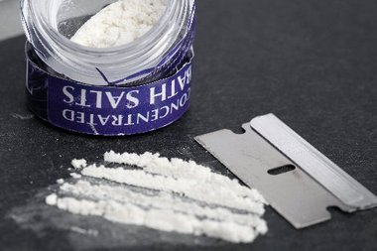
Bath Salts (Also know as The Zombie Drug)
Note that this is not the actual bath salt for the bath, it is a drug. They have the same name for it because it looks very similar.
How it’s used:
Swallow
Snort
Smoke
Inject synthetic cathinones.

Slide 3
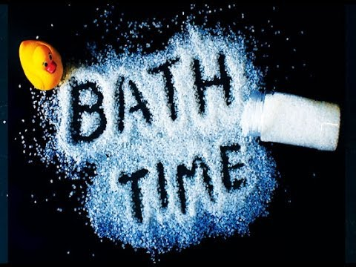
Short-Term Effects
Violent Behavior
Depression
Psychosis
Hallucinations and delusions
Headaches
Seizures
Muscular cramping or tension
Suicidal thoughts
Insomnia
Self-Harm

Slide 4
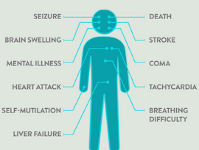
Long-Term Effects
Increased blood pressure and heart rate
Kidney damage and failure
Liver damage
Breakdown of skeletal muscle tissue
(muscles that bring about the movement of the bones of the skeleton)
Brain swelling and brain death
Death

Slide 5
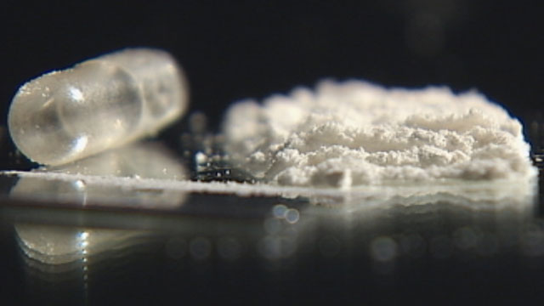
Classified as stimulants
creates aggression and hallucinations
The presumption is that the common drugs to be included are mephedrone, methylone and methylenedioxypyrovalerone (MDPV).

Slide 6
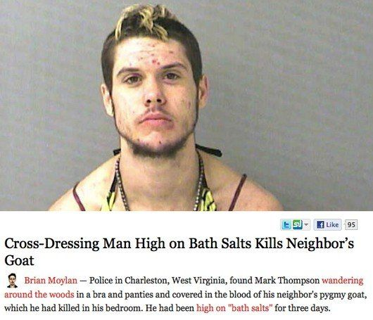
How it affects the body
It is still unknown how it affects the body but researchers know that Synthetic cathinones are chemically similar to amphetamines, cocaine, and MDMA.
These drugs can cause a range of effects including lowered inhibition, anxiety, and depression.

Slide 7
Miami “Zombie” Case
Rudy Eugene,the cannibal who ate the face off of a homeless man he attacked MacArthur Causeway (poppo).Poppo, who was taken to Ryder Trauma Center, survived the attack but has no memory of it. Eugene was naked and under the influence of “bath salts” when he was caught chewing off the victims flesh. The attacker was approached by an officer who told him to stop but instead he growled like a wild animal and kept on eating the man’s face. The drug caused him to become very violent and to take off his clothes. 75% to 80% of the victims face was missing.

Slide 8
Penalties for Having this drug in your possession
The law bans the sale, production and possession of more than two dozen of the most common bath salt drugs
Lawmakers cannot keep pace with bath salt producers, who constantly adjust their chemical formulations to come up with new synthetic drugs that aren't covered by new laws.
making it a misdemeanor to sell, buy or possess the synthetic drug= 6 months in jail and a $1,000 fine

Slide 9
work cited
http://www.drugfreeworld.org/drugfacts/synthetic/bath-salts-effects.html
http://news.blogs.cnn.com/2012/05/29/reports-miami-zombie-attacker-may-have-been-using-bath-salts/

