Slide 1
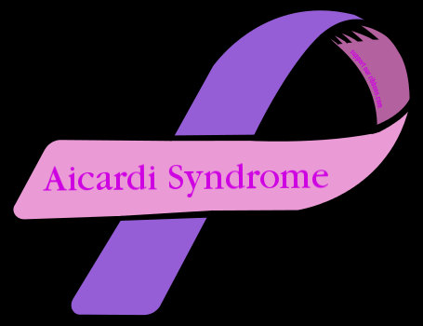
Aicardi Syndrome
Crystal Kahahane

Slide 2
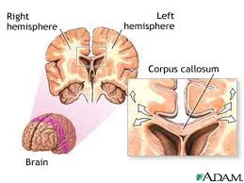
Discovery
Who- French neurologist Dr. Jean Aicardi
What- Rare neurologic epilepsy disorder that occurs mainly in newborn females (46,XX)
When- 1965
Where- France
How- Unknown; possible cause: mosaic mutation

Slide 3
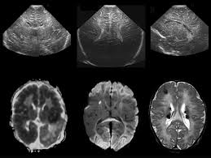
Mode of Inheritance
- Most cases are sporadic, so it is not inherited from parent to child.
- Virtually all cases of Aicardi syndrome are female
- Classified as an X-linked dominant condition.
- Believed to have been resulted from new gene mutations.

Slide 4
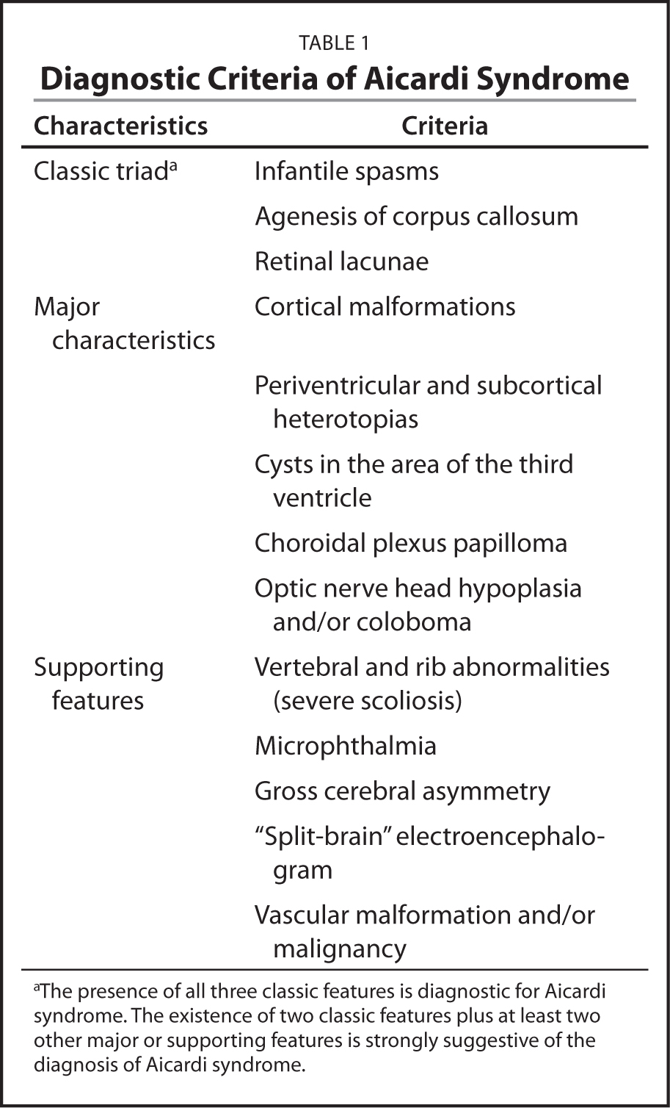
Features & Diagnosis
Three main features:
1.Partial or complete absence of the structure (corpus callosum)
2. Infantile spasms (seizure disorder)
3. Chorioretinal lacunae (yellowish spots on retina)
Diagnosis:
Clinical presentation, and brain imaging determine the diagnosis.

Slide 5
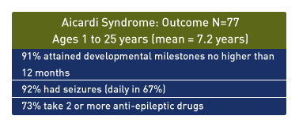
Frequency
- 1,000 cases in the U.S
- 4,000 cases worldwide
- Every 1 in 100,000 live births will be diagnosed with aicardi syndrome

Slide 6
Treatments
Course treatments include:
Pediatric neurology,
Epileptology,
Neurosurgery,
Orthopedics,
Physical and Speech therapy
No cure for Aicardi syndrome

Slide 7
Life Expectancy
People with Aicardi syndrome have an increased risk of death during childhood and adolescence, but there are known survivors.

Slide 8
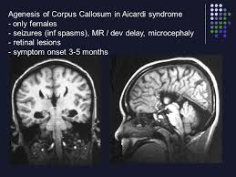
Impacts
Refractory epilepsy, infantile spasms, and seizures occur in all cases and are difficult to treat.
Patients experience

Slide 9
Questions & Answers
Q: Is it possible for males to have this? If so, what is the life expectancy?
A: Yes, it is possible for males to also have this disorder. It may be lethal to certain males born with an extra “X” chromosome.

Slide 10
Bibliography
https://aicardisyndromefoundation.org/aicardi-syndrome/
https://ghr.nlm.nih.gov/condition/aicardi-syndrome
http://www.ninds.nih.gov/disorders/aicardi/aicardi.htm#Is_there_any_treatment
http://www.healthline.com/health/aicardi-syndrome#Symptoms2

