Slide 1
Phencyclidine
(PCP)
Kasey Pacheco and Aubrey Unemori

Slide 2
Introduction
Schedule II Drug
Relatively low cost and easy to manufacture in home laboratories.
Bad reputation among drug addicts and dealers
Can’t guarantee pure form

Slide 3
History
Developed in the 1950s as an anesthetic
Used in pediatric and veterinary medicine
Discontinued by 1960s by Parke Davis
Patients suffered from severe anxiety and agitation.
Usage peaked in 1978
At the time, named the PeaCe Pill.

Slide 4
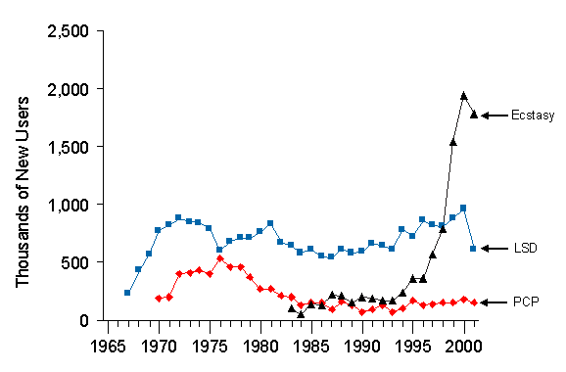
Users of PCP
225,000 individuals aged 12-17 have used PCP at least once.
777,000 individuals aged 18-25 have used PCP at least once.
Approximately 1.0% of high school seniors said they’ve used PCP in the past year.
Growth in New PCP Users
(1965-2001)

Slide 5
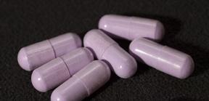
How You Get Stupid off of It
Capsules
Tablets
Powder
Liquid

Slide 6
Effects: Low Doses
Detached
Distant
Estranged from surroundings
Numbness
Slurred speech
No coordination
Blank state
Rapid and involuntary eye movements
Exaggerated gait
Induced feelings of strength, power, and invulnerability.

Slide 7
Effects: High Doses
Nausea and vomiting
Blurred vision
Flicking up and down of eyes
Drooling
Loss of balance
Dizziness
Drop in…
Blood pressure
Pulse rate
Respiration

Slide 8
Effects: Long-Term
Impairment in…
Memory
Speech
Cognition
Psychotic episodes resembling Schizophrenia
Increased breathing rate
Shallow breathing
Profuse sweating
Auditory hallucinations
Image distortion
Mood disorders
Amnesia
Acute anxiety
Paranoia
Violent hostility
Feeling of IMPENDING DOOM.

Slide 9
DEATH
(Though more likely resulting from accidental injury or suicide while on PCP)

Slide 10
PCP Cases
Andre Johnson
Chevonne Thomas
Osvaldo Rivera

Slide 11
PCP Cases
Angelo Mendoza Sr.
Big Lurch
Houston

Slide 12
Identifying a PCP User
Urine testing - 10% of PCP is excreted in urine, approximately 3-7 days.
Hair testing - Up to 90 days after usage.
Blood testing - Between 1-3 days after usage.

Slide 13
Penalties for Possession
First offense - Between 5 and 40 years in prison and/or a fine of $2 million for possession of 100 - 999 grams.
More than one kilogram may face second offense penalties
Second offense - Between 10 years and lifetime in prison and/or a fine of $4 million.
More than one kilogram may face 20 years to life in prison and/or a fine of $8 million.

Slide 14
Works Cited
Long, Philip W. “Phencyclidine Use Disorder.” Internet
Mental Health. Internet Mental Health, n.d. Web. 15
Jan. 2016.
“PCP Fast Facts.” National Drug Intelligence Center. U.S.
Department of Justice, n.d. Web. 20 Jan. 2016.
“Phencyclidine (PCP).” Center for Substance Abuse Research.
University of Maryland, 19 Oct. 2013. Web. 20 January
2016.
“PCP (Phencyclidine).” Drugs.com. 8 May 2014. Web. 15
Jan. 2016.

