Slide 1
Oxycodone
Megan Nashiwa &
Mitchell Johnsen

Slide 2
Origin
Originated around the 1800, then sold by counter around 1900.
Potentially from opium stems with a morphine base in it.

Slide 3
Identification & Uses
Usually identified as a small white pill.
Can be swallowed or liquified and injected.
Legally only used for prescription use only by doctor as swallowing pill.
Illegally used as any other illegal drug for overdose or pleasure taken by swallowing or injection.

Slide 4
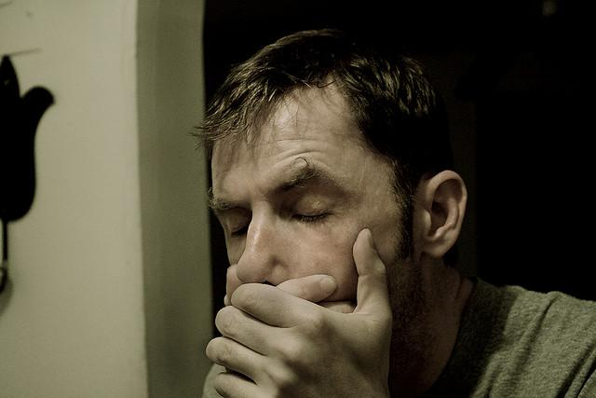
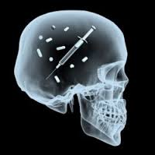
Effects
Disorientation
Nausea/Vomiting
Addiction
Physical effects on the body
Weakness
Constipation
Excessive sweating
Severe headaches

Slide 5
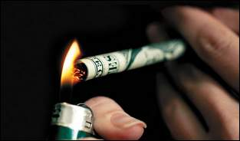
Penalty
A person selling or attempting to sell Oxycodone can face 5-20 years in prison and/or a fine of $250,000 to $5,000,000.
If a person is convicted of selling Oxycodone near a school zone or other specified facilities, then the penalty doubles.
If a person dies in result if the drug sale, then the defendant may face life in prison.
Possession of Oxycodone intending to use it for personal use, without a prescription, can result in prison time from 1-5 years and some criminal charges depending on the state laws.

Slide 6
Conclusion
Don’t do Oxycodone non prescriptively or over dose. It is bad and extremely dangerous.
Gorison, Hunter L. "The History of Oxycodone." EHow.com. Demand Media, 2015. Web. 19 Jan. 2016.
Megan

