Slide 1
Heroin
By Kylor sparks & JD

Slide 3
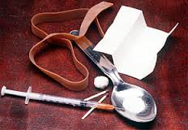
What paraphernalia is used?
Rubber band or something to tie off your arm.
Needle for injection
Spoon
Lighter or matches to melt the heroin

Slide 5
Heroin nicknames
Dragon (smoking heroin is called “Chasing the Dragon”)
Dope
Snowball
Big H
White
White Lady
China White
Mexican Mud
Horse
Scag

Slide 6
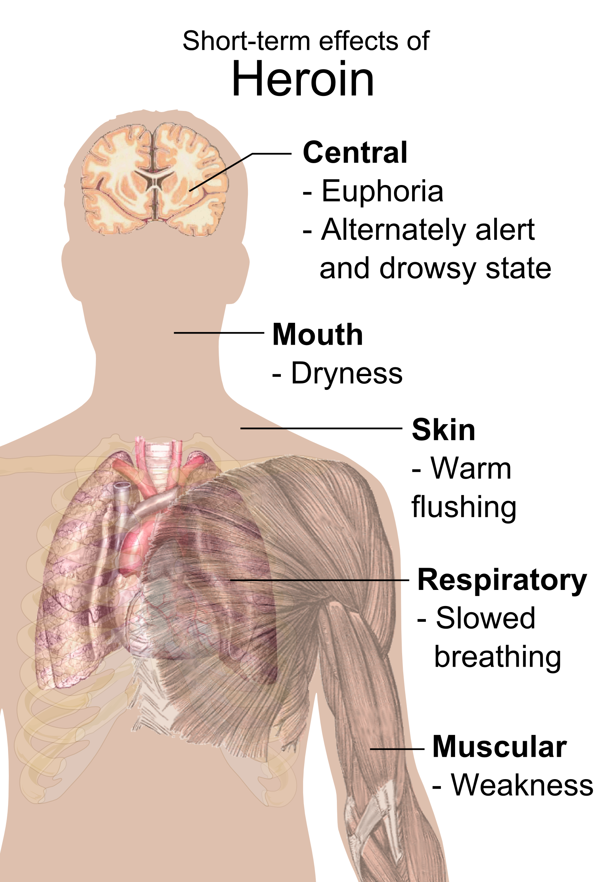
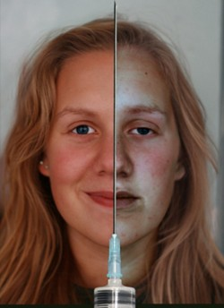
Short-Term Effects
A “rush”
Warm flushing of the skin
Dry mouth
Nausea
Vomiting
Severe itching

Slide 7
Long-Term Effects
Addiction
Tolerance
Physical Withdrawal
Psychological Withdrawal
Failure to quit
Disease
Blood-borne
Hepatitis B and C
HIV
Liver Cancer

Slide 8
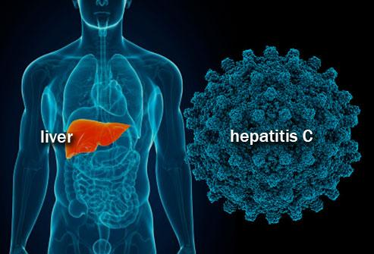
Long-Term Effects
Hepatitis C (HCV)
Most prevalent blood-borne disease throughout world
57 percent of IV drug users may be infected with HCV
As many as 5.2 million people in the US may be infected with HCV
The risk of HCV increases in people who also have HIV

Slide 9
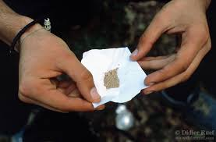
Long-Term Effects
The Lungs
Slows down central nervous system
Pneumonia
Tuberculosis
changes the physical structure of the brain
Withdrawal (restlessness, muscle and bone pain, insomnia, diarrhea, vomiting, cold flashes with goose bumps (“cold turkey”), and leg movements)
long-term imbalances in neuronal and hormonal systems

Slide 10
Long-Term Effects
Overdose (Ultimate side-effect)
Higher risk:
Are going through withdrawal
Have a reduced tolerance because they’ve been clean for a while
Mix heroin with other drugs, like cocaine, tranquilizers or alcohol
Have had an overdose in the past
Are depressed or suicidal
Suppresses vital functions

Slide 11
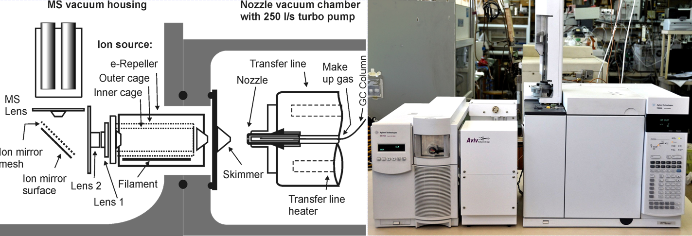
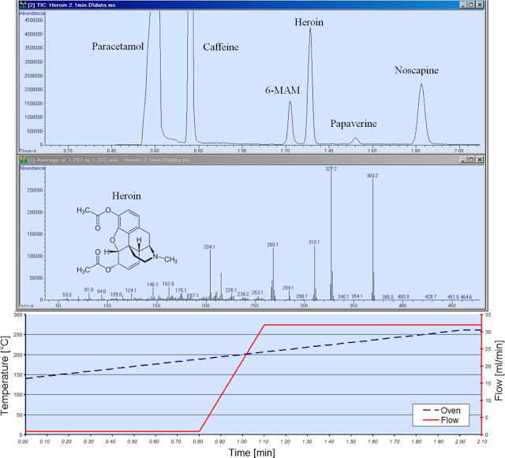
Analysis and Identification
Quick Analysis
The Aviv Analytical 5975-SMB GC-MS with Cold EI is used
Achieves very fast (under 3 min) full analysis

Slide 12
Penalty for possession
If you are found to be in possession of the street drug heroin you will likely be facing some jail time.
Less than 1 gram: a state jail felony with possible punishment of up to 2 years in jail and a fine of up to $10,000
1-4 grams: a 2nd degree felony with possible punishment of 2-20 years and fine of up to $10,000
4-200 grams: a 1st degree felony with a possible punishment of 5-99 years and up to a $10,000 fine
200-400 grams: a 1st degree enhanced felony punishable by 10-99 years in prison and a fine of up to $100,000
400 grams or more: a 1st degree enhanced felony punishable by life in prison or 15-99 years and a fine of up to $250,000

Slide 14
Sources
http://www.drugabuse.gov/publications/research-reports/heroin/what-are-immediate-short-term-effects-heroin-use
http://www.addictionsearch.com/substance-addictions/114/heroin-substance-abuse-heroin-addiction/
http://luxury.rehabs.com/heroin-addiction/long-term-effects/
http://www.narconon.org/drug-abuse/heroin/nicknames.html
http://criminal.findlaw.com/criminal-charges/drug-dealing-and-drug-sales-charges.html
http://blog.avivanalytical.com/2012/09/very-fast-heroin-analysis-role-of-flow.html

