Slide 1
Drug Report Project:
Crack Cocaine
By: Samantha Barth

Slide 2
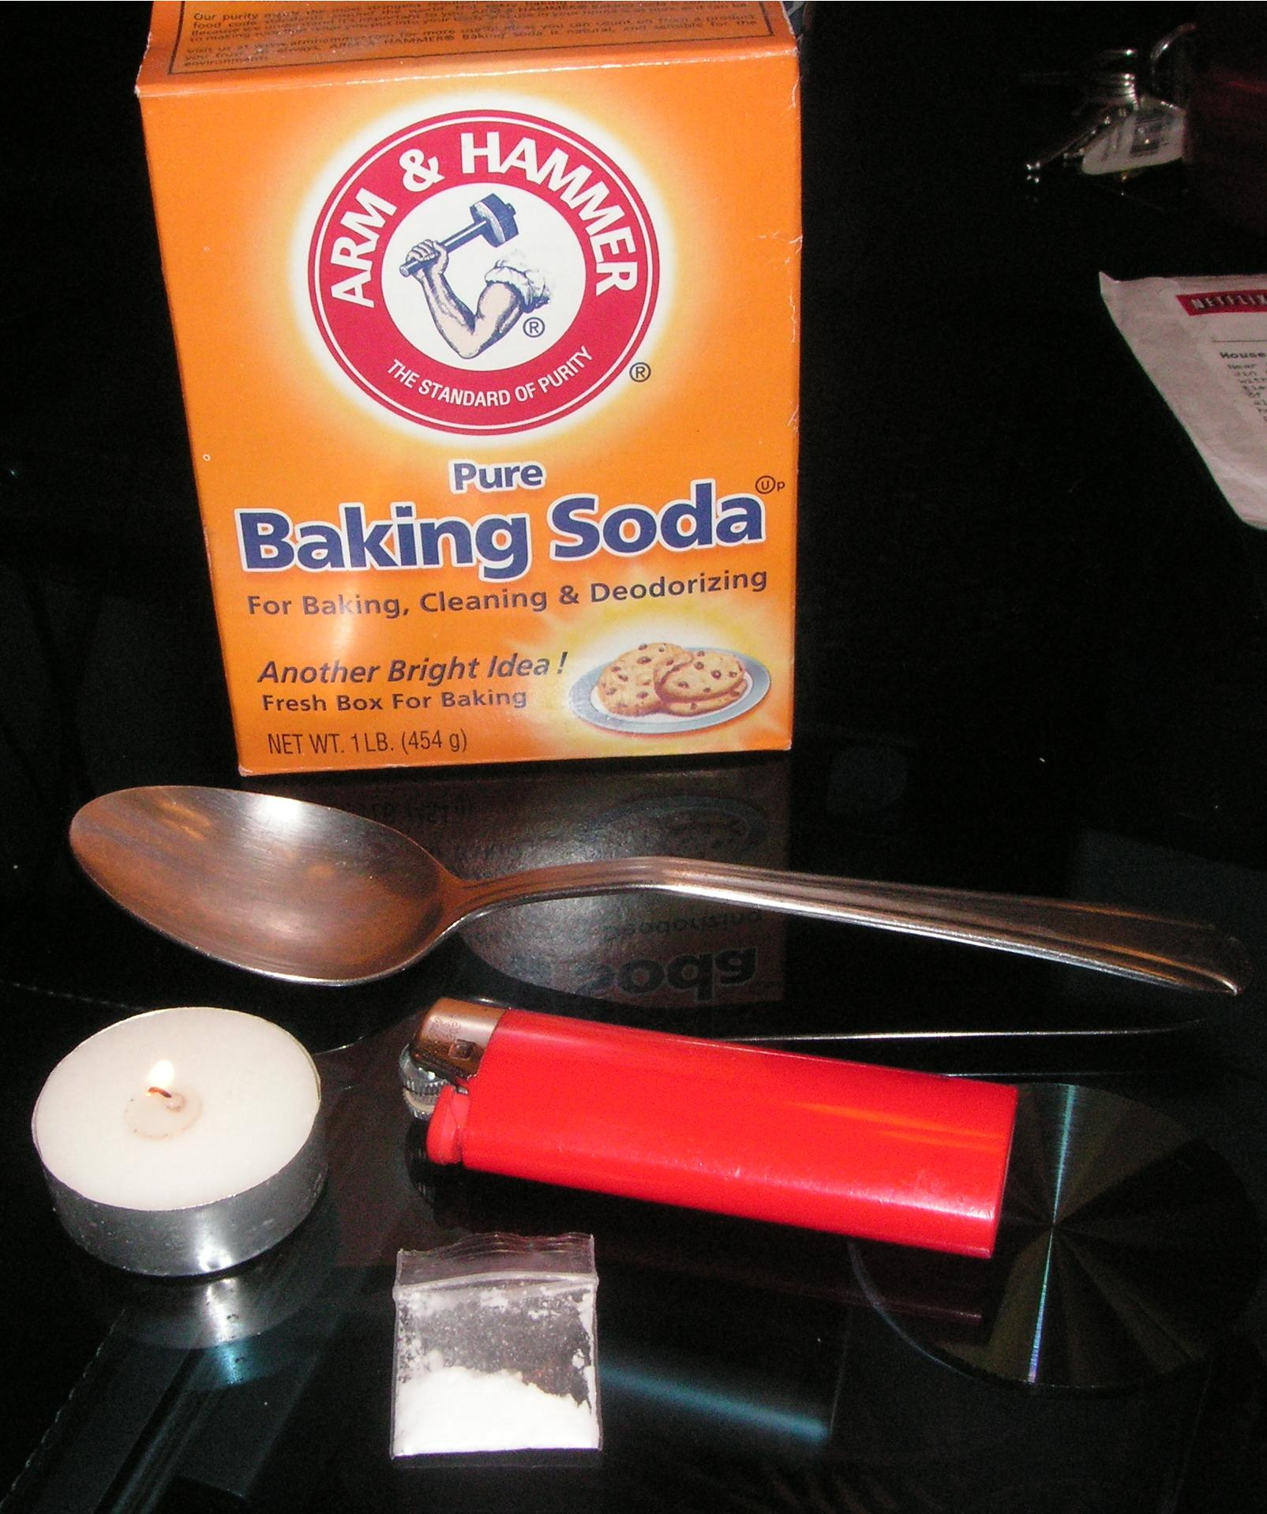
What does Crack Cocaine look like?
Crack Cocaine is usually available in rock form. Crack rocks are white or off white and come in a variety of sizes.
What kind of paraphernalia is usually associated with this drug?
The usual paraphernalia for smoking crack, include smoking pipes, lighters, and customized gadgets.

Slide 3
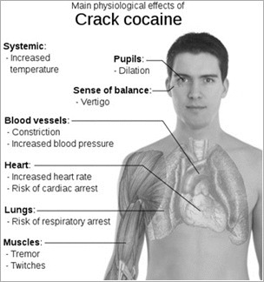
What are the short term effects of Crack Cocaine?
The immediate effects of Crack Cocaine are...
Dilated pupils
Dry mouth
Sweating
Little Appetite
Restlessness
Talkativeness

Slide 4
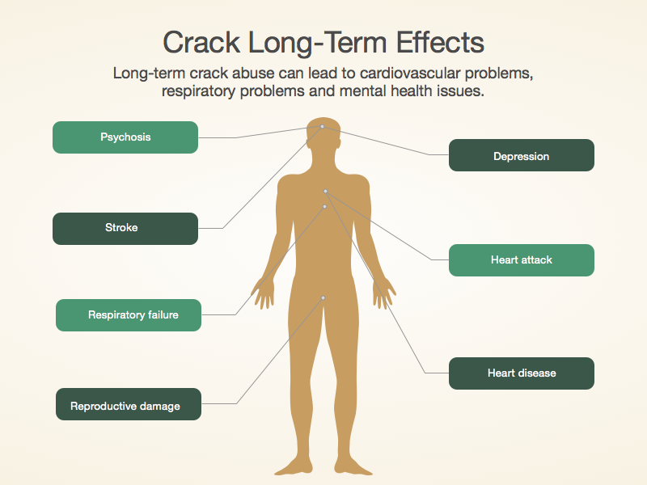
What are the long term effects of Crack Cocaine?
The long term effects of Crack Cocaine are…
Stroke
Depression
Heart Attack
Heart Disease
Respiratory Failure
Reproductive Damage
Psychosis

Slide 5
How is Crack Cocaine analyzed and identified?
Crack Cocaine is analyzed in a Mass Spectrometer. To make Crack Cocaine “First the leaves of the coca plant are dried Next, the leaves are chopped into small pieces then a small amount of powdered cement is added on top of the leaves, and then soak in gasoline for a day. The gasoline is then taken out .Next, battery acid is added to the cocaine-gasoline liquid. The cocaine free base liquid is poured into buckets. Then powdered caustic soda is added to it, which lets the cocaine precipitate. This can then be strained through a cloth to form a paste. This paste will contain 40% to 60% cocaine. The cocaine is then cooked with baking soda to form crack cocaine ”

Slide 6
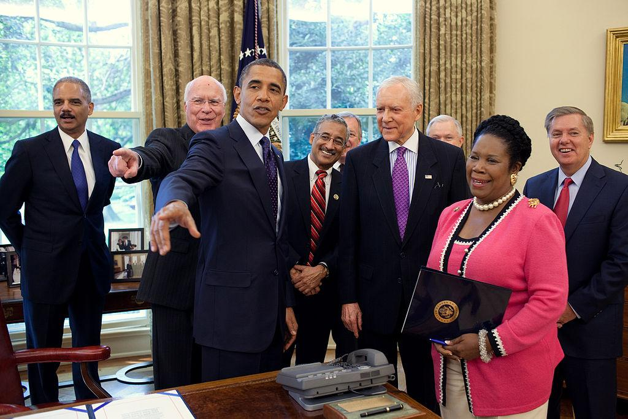
What is the penalty for having Crack Cocaine in your possession?
The minimum sentence for having crack cocaine in your possession is a 10 to 20 year mandatory prison sentence.
IN 2010 President Obama passed the equal penalty law that , made the punishment for having Crack Cocaine equal to the punishment for having regular Cocaine in your possession.

