Slide 1
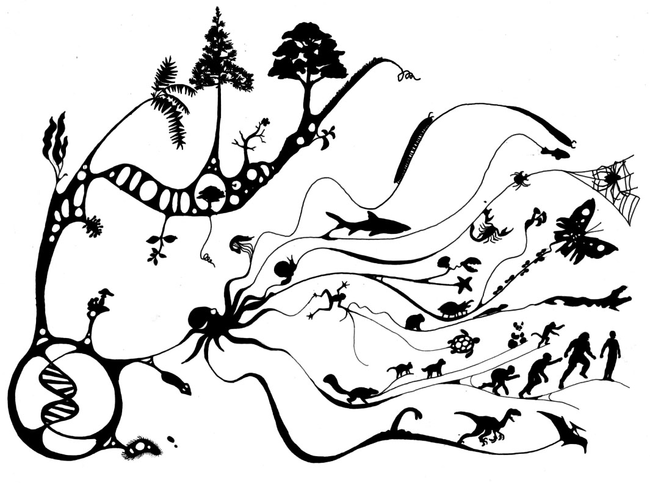
Chapter 23: The Evolution of Populations

Slide 2
Must Know:
How mutation and sexual reproduction each produce genetic variation.
the conditions for Hardy-Weinberg equilibrium.
How to use the Hardy Weinberg equation to calculate allele frequencies to test whether a population is evolving.
What effects genetic drift migration or selection may have on population, and analyze data to justify your prediction.

Slide 3
1. Individual variations often reflect________, differences among individuals in the composition of their genes or other DNA segments.
a. Geographic variation
b. Natural selection
c. Genetic variation
d. Microevolution

Slide 4
2. Which of the following is an example of nonheritable variation?
a. Nemoria arizonaria caterpillars differ in appearance due to chemicals in their diet.
b. The dark pepper moth blended into the tree more than the white moth, resulting in a greater number of dark moths.
c. The fruit fly Drosophila melanogaster has an average heterozygosity of 14%.
d. Individuals do not evolve. Populations evolve.

Slide 5
3. What is the Hardy-Weinberg Equilibrium equation?
A) a²+b²=c²
B) p²+2pq+q²=1
C) 2p+pq²+2q=1
D) e=mc²

Slide 6
4. What is not one of the 5 conditions for the Hardy-Weinberg Equilibrium?
a) Natural selection
b) No gene flow
c) Random mating
d) No mutations
e) Large populations

Slide 7
5. Genetic drift occurs more in _______ populations.
a. Smaller
b. Larger
c. Marine
d. Plant

Slide 8
6. Gene flow does not affect the…
a. allele frequencies
b. population diversity
c. location of the species
d. adaptations made

Slide 9
7. Why can’t natural selection create perfect organisms?
a. Selection can only act on existing variations
b. Evolution is limited by historical constraints
c. Adaptations are often compromises
d. Chance, natural selection, and the environment interact
e. All of the above
f. What are you talking about? Aren’t humans perfect?

Slide 10
8. ________ selection, also known as mate choice, is where individuals of one sex are picky when selecting a mate.
a. balancing
b. natural
c. intersexual
d. intrasexual
e. mate

Slide 11
23.1: Genetic Variation Makes Evolution possible
Individuals Populations
___________ do not evolve, ___________ evolve.
2. We can define evolution on its smallest scale, called _______________, as change in allele frequencies in a population over generations.
3. Natural selection acts on __________, but the evolutionary impact of natural selection is only apparent in the changes in a ___________ of ___________ over time.
Microevolution
Individuals
Population Organisms

Slide 12
4. There are three main mechanisms that can cause allele frequency change:_________________, ____________ and __________. However, only _________________is adaptive.
5.____________________can be classified on an either-or basis, while _______________________ are heritable features that vary along a continuum within a population.
6.Individual variations often reflect__________________, differences among individuals in the composition of their ______ or other DNA segments.
Natural selection genetic drift
gene flow Natural selection
Discrete characters
quantitative characters
genetic variation
genes

Slide 13
nonheritable variation
Nemoria arizonaria
7. An example of ______________________ is the caterpillars of the moth ___________________, who owe their different appearances to chemicals in their diet.
8. Gene variability can be quantified as the _________
_______________, the average percentage of a loci that are heterozygous.
Example: On average, the fruit fly Drosophilia melanogaster is heterozygous for about 1,920 of its 13,700 loci (14%) and homozygous for the rest. Therefore, a D. melanogaster population has an average heterozygosity of 14%.
9. One method of identifying __________________is to survey the protein products of genes using gel electrophoresis.
Average
heterozygosity
heterozygous loci

Slide 14
nucleotide variability
10. To measure ____________________, biologists compare the DNA sequences of two individuals in a population and then average the data from many such comparisons.
11. _____________________ is the differences in the genetic composition of separate populations
12. A ______ is a graded change in a character along a geographic axis.
Geographic variation
cline

Slide 15
13. Chromosomal changes that delete, disrupt, or rearrange many loci at once are usually ________.
14. A change of as little as one base in a gene, called a ______________ , can have a significant impact on the phenotype, as in sickle-cell disease.
15. In organisms that reproduce________ , most of the genetic variation in a population results from the unique combination of alleles that each individual receives from its _______.
Harmful
point mutation
sexually
parents

Slide 16
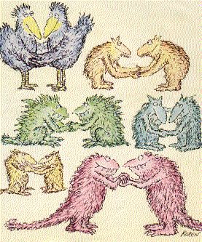
23.2: The Hardy-Weinberg Equilibrium
Key Ideas:
The frequency of each allele in a population that is not effected by evolution.
Conditions for Hardy-Weinberg Equilibrium

Slide 17
Practice Problem #1
You have sampled a population in which you know that the percentage of the homozygous recessive genotype (aa) is 36%. Using that 36%, calculate the following:
a) The frequency of the "aa" genotype.
b) The frequency of the "a" allele.
c) The frequency of the "A" allele.
d) The frequencies of the genotypes "AA" and "Aa."
e) The frequencies of the two possible phenotypes if "A" is completely dominant over "a."

Slide 18
Practice Problem #2
A rather large population of Biology instructors have 396 red-sided individuals and 557 tan-sided individuals. Assume that red is totally recessive. Please calculate the following:
a) The allele frequencies of each allele.
b) The expected genotype frequencies.
c) The number of heterozygous individuals that you would predict to be in this population.
d) The expected phenotype frequencies.
e) Conditions happen to be really good this year for breeding and next year there are 1,245 young "potential" Biology instructors. Assuming that all of the Hardy-Weinberg conditions are met, how many of these would you expect to be red-sided and how many tan-sided?

Slide 19
Gene Pools and Allele Frequencies
What is a population?
We can characterize a population's genetic makeup by describing its ______ _____, which consists of all copies of every type of allele at every locus in all members of the population.
Note: _______ is a variant in similar DNA
A group of individuals of the same species that live in the same area and interbreed, producing fertile offspring.
gene pool
Locus

Slide 20
The Hardy-Weinberg Equilibrium
The gene pool of a population that is evolving can be described by the _________________________. This principle states that the frequencies of alleles and genotypes in a population will remain constant from generation to generation, provided that only ___________ segregation and ______________ of alleles are at work.
Hardy-Weinberg principle
Mendelian
recombination

Slide 21
Conditions for the Hardy-Weinberg Equilibrium :
Change can occur when at least one of the following five conditions of Hardy-Weinberg Equilibrium is not met:
1. No Mutations; The gene pool is modified if __________ alter alleles or if entire genes are ________ or ___________.
2. Random Mating; If individuals mate preferentially then ________ mixing of gametes does not
3. No Natural Selection; Differences in the _________ and ___________ success in individuals carrying different genotype frequencies change. 4. Extremely Large Population Size; The _________ the population, the more likely allele frequency will fluctuate by chance.
5. No Gene Flow; By moving alleles into and out of populations, gene flow can alter allele frequencies.
Mutations
deleted duplicated
random
survival reproductive
smaller

Slide 22
23.3 Natural Selection, Genetic Drift, and Gene Flow
1. The _______ the sample size, the more likely the deviation in the sample size is affected by chance.
2. Genetic drift is the process of.....
Smaller
The unpredicted fluctuations from one generation to the next caused by chance

Slide 23
23.3 Natural Selection, Genetic Drift, and Gene Flow
3. When a few individuals become ________ from a larger population, this smaller group may establish a new population whose _____ _____ differs from the source population; this is called the founder effect
4. The Bottleneck Effect occurs after a severe _____ in population size leaving the gene pool to the survivors
isolated
gene pool
drop

Slide 24
23.3 Natural Selection, Genetic Drift, and Gene Flow
Key Points on Genetic Drift:
Genetic drift is significant in small populations
Genetic drift can cause allele frequencies to change at random
Genetic drift can lead to a loss of genetic variation within populations
Genetic drift can cause harmful alleles to become fixed
6. Gene Flow:
The transfer of alleles into or out of a population due to the movement of fertile individuals or their gametes

Slide 25
23.4 Natural Selection Causes Adaptive Evolution

Slide 26
Adaptive Evolution and Selection Methods
___________ occurs when conditions favor individuals exhibiting one extreme of a phenotypic range.
_________ occurs when conditions favor individuals at both extremes of a phenotypic range over individuals with intermediate phenotypes.
__________ acts against both extreme phenotypes and favors the intermediate variants.
As the proportion of individuals that have __________ traits increases, the match between a species and its ____________ improves.
Directional
Disruptive
Stabilizing
favorable
environment

Slide 27
Adaptive Evolution and Selection Methods
________ selection is a form of selection where individuals with certain characteristics are more likely to gain mates.
___________ selection is where individuals within the same sex compete directly for mates of the opposite sex. __________ prevent others from mating.
___________ selection, also known as mate choice, is where individuals of one sex are picky and look for certain traits when choosing a mate. This may result in _______ ____________.
Sexual
Intrasexual
Individuals
Intersexual
sexual dimorphism

Slide 28
Preservation of Genetic Variation
Balancing
____________ selection is where natural selection maintains 2 or more forms in a population.
When a species has a ________ loci there recessive genetics may be hidden by their phenotype, but this makes a species resistant to ________.
Having an advantage because an individual contains both a dominant and recessive gene is also known as _____________ advantage.
_______________________ selection is where the fitness of a phenotype depends on how common it is in the population.
diplody
change
heterozygote
Frequency-dependent

Slide 29
Why Natural Selection Cannot Fashion Perfect Organisms
existing
Selection can only act on ________ variations
Evolution is ________ by historical constraints
___________ are often compromises
Chance, _______ selection, and the ___________ interact
limited
Adaptations
natural environment

Slide 30
Individual variations often reflect________, differences among individuals in the composition of their genes or other DNA segments.
a. Geographic variation
b. Natural selection
c. Genetic variation
d. Microevolution

Slide 31
Which of the following is an example of nonheritable variation?
a. Nemoria arizonaria caterpillars differ in appearance due to chemicals in their diet.
b. The dark pepper moth blended into the tree more than the white moth, resulting in a greater number of dark moths.
c. The fruit fly Drosophila melanogaster has an average heterozygosity of 14%.
d. Individuals do not evolve. Populations evolve.

Slide 32
What is the Hardy-Weinberg Equilibrium equation?
A) a²+b²=c²
B) p²+2pq+q²=1
C) 2p+pq²+2q=1
D) e=mc²

Slide 33
What is not one of the 5 conditions for the Hardy-Weinberg Equilibrium?
a) Natural selection
b) No gene flow
c) Random mating
d) No mutations
e) Large populations

Slide 34
Genetic drift occurs more in _______ populations.
a. Smaller
b. Larger
c. Marine
d. Plant

Slide 35
Gene flow does not affect the…
a. allele frequencies
b. population diversity
c. location of the species
d. adaptations made

Slide 36
Why can’t natural selection create perfect organisms?
a. Selection can only act on existing variations
b. Evolution is limited by historical constraints
c. Adaptations are often compromises
d. Chance, natural selection, and the environment interact
e. All of the above
f. What are you talking about? Aren’t humans perfect?

Slide 37
________ selection, also known as mate choice, is where individuals of one sex are picky when selecting a mate.
a. balancing
b. natural
c. intersexual
d. intrasexual
e. mate

