Slide 1
Comparing DNA Sequences to Understand Evolutionary Relationships with BLAST
INVESTIGATION 3
BIG IDEA 1

Slide 2
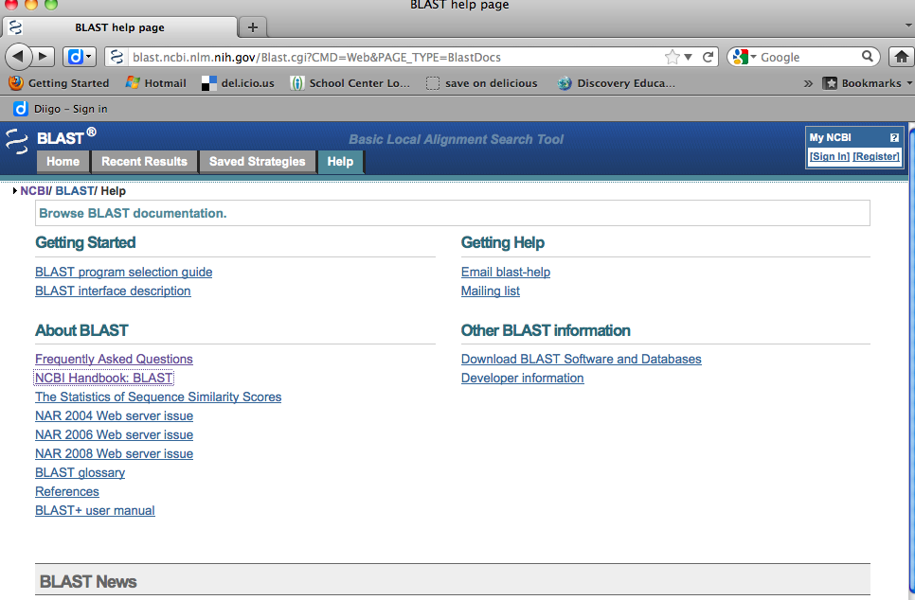
Tutorials for BLAST at NCBI

Slide 3
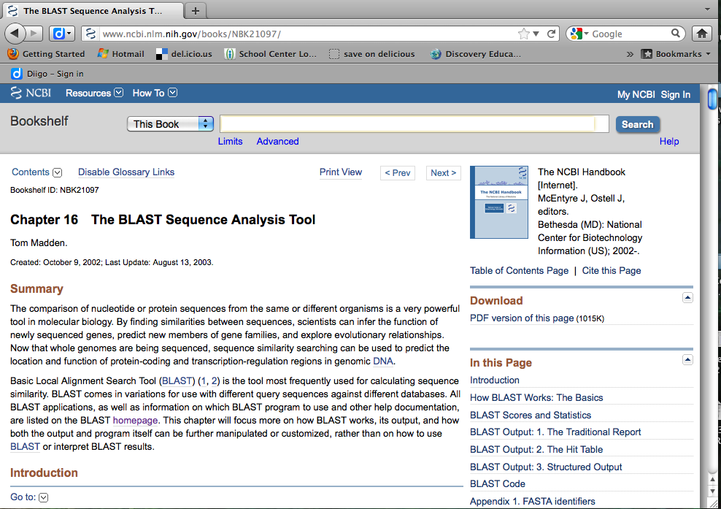
The NCBI Handbook

Slide 4
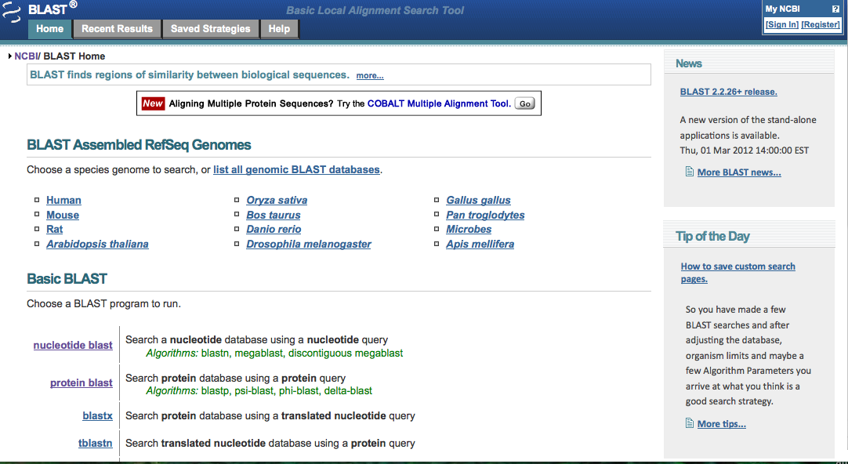
BLAST Home Page

Slide 5
Student Investigation
Getting Started (pages S43 & S44)
  Table 1: students construct a cladogram of the major plant groups.
  Table 2: students construct a cladogram depicting evolutionary relationships among 5 species according to percent similarity.

Slide 6
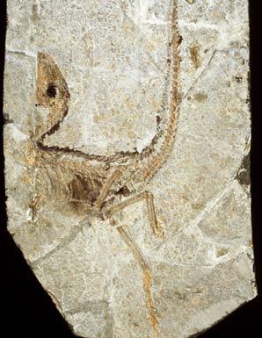
Student Investigation
Team of scientists uncovered this fossil specimen in China.
Students make general observations about morphology and record those in lab notebook. (Page S44)
http://www.pbs.org/wgbh/nova/microraptor/foss-09.html

Slide 7
Student Investigation
Procedure (page S45)
  STEP 1: Students form initial hypothesis as where they think the fossil specimen should be placed on the cladogram based on morphological observations made earlier.
  Task is to use BLAST to determine most likely placement of fossil species in a cladogram
  Based on DNA sequences extracted from tissue

Slide 8
Student Investigation
Procedure (page S45)
STEP 2: Students locate and download 3 gene files from Using Blogs In Science Education site.
http://blogging4biology.edublogs.org/2010/08/28/college-board-lab-files/
Remind students that they cannot open files, but must upload to BLAST to view sequences.

Slide 9
Student Investigation
STEP 3: Students upload first gene sequence into BLAST by going to BLAST home page and clicking on “Saved Strategies” from menu at top of page.

Slide 10
BLAST Home Page

Slide 11
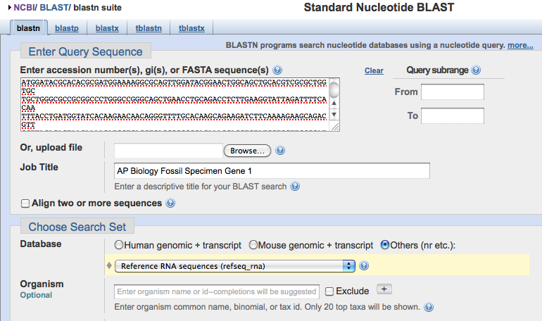
Uploading Gene Sequences
Click on “View” and upload a gene sequence. You cannot view the file on your computer.

Slide 12
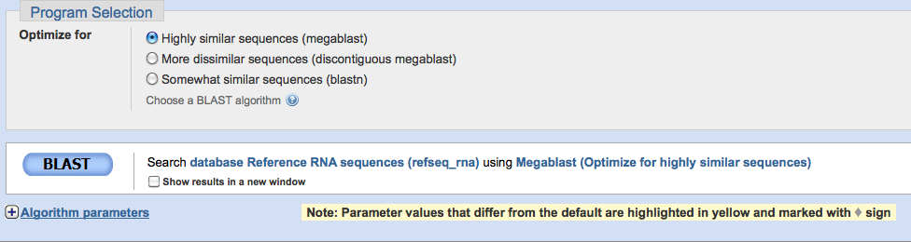
Click on BLAST
Click on BLAST button at the bottom of the page.

Slide 13
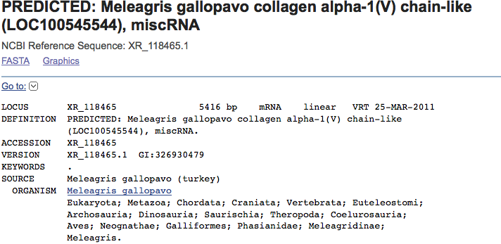
Results
Click on a particular species to find out more specific information, including the classification scheme and the sequence of bases that appear to align with your gene of interest.

Slide 14
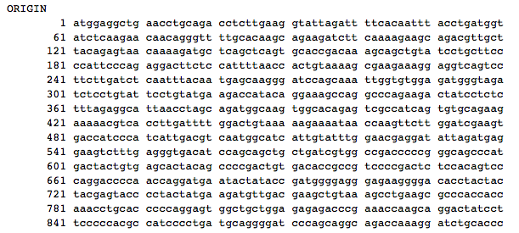
Results
Click on a particular species to find out more specific information, including the classification scheme and the sequence of bases that appear to align with your gene of interest.

Slide 15
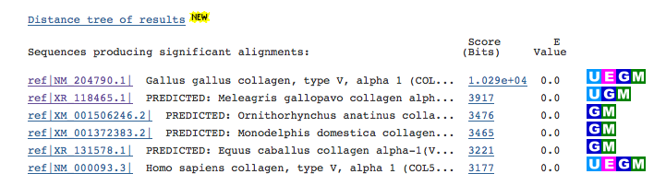
Distance Tree of Results

Slide 16
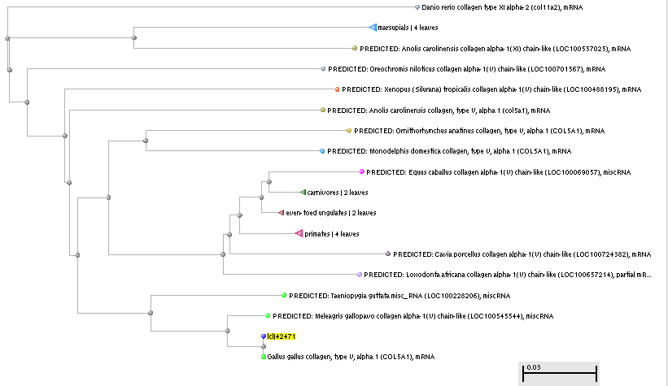
The Cladogram

Slide 17
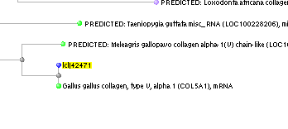
The Cladogram
This is a close-up of what you will see. Your gene of interest is highlighted in yellow.

Slide 18
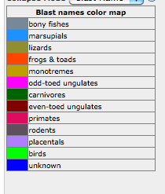
The Cladogram
In addition, you will be provided with a “BLAST names color map” that looks like this so that you can better understand the cladogramyour search produced.

Slide 19
What’s next?
Students will
  Repeat this process for 2 other genes of interest.
  Analyze their results.
  Decide whether or not the data from the BLAST search support their hypothesis about the placement of the fossil species on the cladogram.
  Compare and discuss cladogram with other students.

Slide 20
Design and Conduct Investigation
Students will
  Find and BLAST their own genes of interest.
  Use example procedure provided.
  Possibly use one or more of the suggested genes to explore.
  OR
  use another source like SWAMI or ENSI before or after doing this lab.

Slide 21
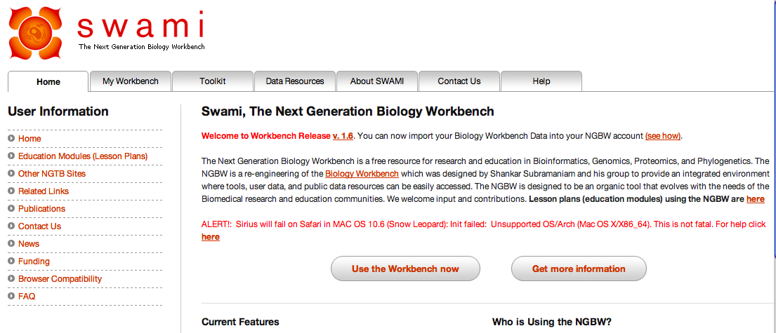
SWAMI

Slide 22
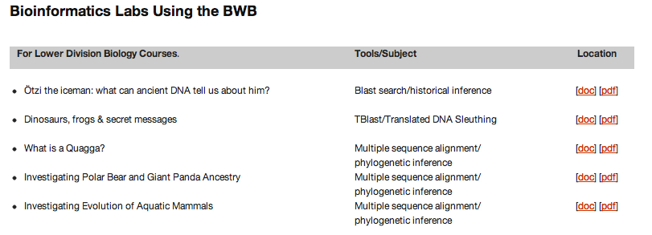
SWAMI

Slide 23
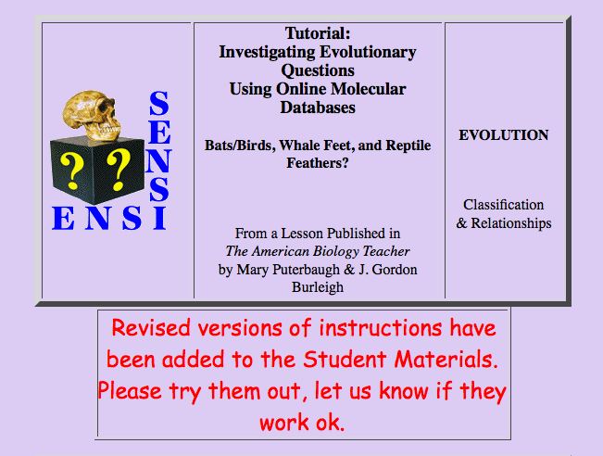
ENSI

