Slide 1
AP Biology Intro to Statistic

Slide 2
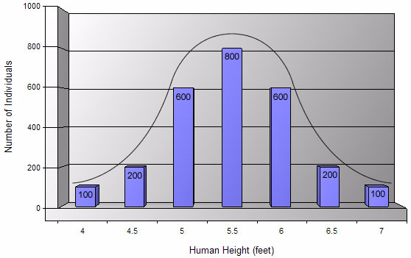
Statistics
Statistical analysis is used to collect a sample size of data which can infer what is occurring in the general population
More practical for most biological studies
Requires math and graphing data
Typical data will show a normal distribution (bell shaped curve).
Range of data

Slide 3
Statistical Analysis
Two important considerations
How much variation do I expect in my data?
What would be the appropriate sample size?

Slide 4
Measures of Central Tendencies
Mean
Average of data set
Median
Middle value of data set
Not sensitive to outlying data
Mode
Most common value of data set

Slide 5
Measures of Average
Mean: average of the data set
Steps:
Add all the numbers and then divide by how many numbers you added together
Example: 3, 4, 5, 6, 7
3+4+5+6+7= 25
25 divided by 5 = 5
The mean is 5

Slide 6
Measures of Average
Median: the middle number in a range of data points
Steps:
Arrange data points in numerical order. The middle number is the median
If there is an even number of data points, average the two middle numbers
Mode: value that appears most often
Example: 1, 6, 4, 13, 9, 10, 6, 3, 19
1, 3, 4, 6, 6, 9, 10, 13, 19
Median = 6
Mode = 6

Slide 7
Measures of Variability
Standard Deviation
In normal distribution, about 68% of values are within one standard deviation of the mean
Often report data in terms of +/- standard deviation
It shows how much variation there is from the "average" (mean).
If data points are close together, the standard deviation with be small
If data points are spread out, the standard deviation will be larger

Slide 8
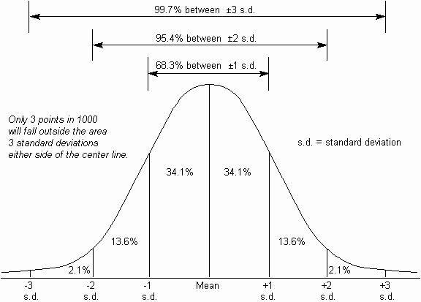
Standard Deviation
1 standard deviation from the mean in either direction on horizontal axis represents 68% of the data
2 standard deviations from the mean and will include ~95% of your data
3 standard deviations form the mean and will include ~99% of your data
Bozeman video: Standard Deviation

Slide 9
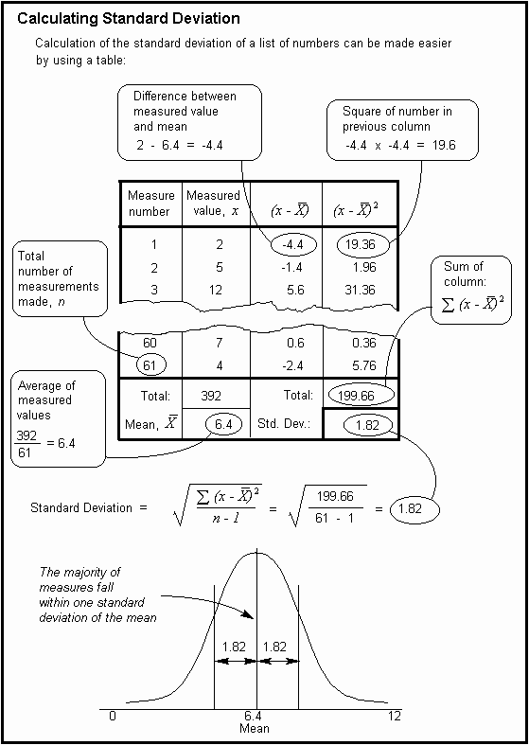
Calculating Standard Deviation

Slide 10
Calculating Standard Deviation
Grades from recent quiz in AP Biology:
96, 96, 93, 90, 88, 86, 86, 84, 80, 70
1st Step:
find the mean (X)
Measure Number | Measured Value x | (x - X) | (x - X)²
1 | 96 | 9 | 81
2 | 96 | 9 | 81
3 | 92 | 5 | 25
4 | 90 | 3 | 9
5 | 88 | 1 | 1
6 | 86 | -1 | 1
7 | 86 | -1 | 1
8 | 84 | -3 | 9
9 | 80 | -7 | 49
10 | 70 | -17 | 289
TOTAL | 868 | TOTAL | 546
Mean, X | 87 | Std Dev

Slide 11
Calculating Standard Deviation
2nd Step:
determine the deviation from the mean for each grade then square it
Measure Number | Measured Value x | (x - X) | (x - X)²
1 | 96 | 9 | 81
2 | 96 | 9 | 81
3 | 92 | 5 | 25
4 | 90 | 3 | 9
5 | 88 | 1 | 1
6 | 86 | -1 | 1
7 | 86 | -1 | 1
8 | 84 | -3 | 9
9 | 80 | -7 | 49
10 | 70 | -17 | 289
TOTAL | 868 | TOTAL | 546
Mean, X | 87 | Std Dev

Slide 12
Calculating Standard Deviation
Step 3:
Calculate degrees of freedom (n-1)
where n = number of data values
So, 10 – 1 = 9
Measure Number | Measured Value x | (x - X) | (x - X)²
1 | 96 | 9 | 81
2 | 96 | 9 | 81
3 | 92 | 5 | 25
4 | 90 | 3 | 9
5 | 88 | 1 | 1
6 | 86 | -1 | 1
7 | 86 | -1 | 1
8 | 84 | -3 | 9
9 | 80 | -7 | 49
10 | 70 | -17 | 289
TOTAL | 868 | TOTAL | 546
Mean, X | 87 | Std Dev

Slide 13
Calculating Standard Deviation
Step 4:
Put it all together to calculate S
S = √(546/9)
= 7.79
= 8
Measure Number | Measured Value x | (x - X) | (x - X)²
1 | 96 | 9 | 81
2 | 96 | 9 | 81
3 | 92 | 5 | 25
4 | 90 | 3 | 9
5 | 88 | 1 | 1
6 | 86 | -1 | 1
7 | 86 | -1 | 1
8 | 84 | -3 | 9
9 | 80 | -7 | 49
10 | 70 | -17 | 289
TOTAL | 868 | TOTAL | 546
Mean, X | 87 | Std Dev | 8

Slide 14
Calculating Standard Error
So for the class data:
Mean = 87
Standard deviation (S) = 8
1 s.d. would be (87 – 8) thru (87 + 8) or 81-95
So, 68.3% of the data should fall between 81 and 95
2 s.d. would be (87 – 16) thru (87 + 16) or 71-103
So, 95.4% of the data should fall between 71 and 103
3 s.d. would be (87 – 24) thru (87 + 24) or 63-111
So, 99.7% of the data should fall between 63 and 111

Slide 15
Measures of Variability
Standard Error of the Mean (SEM)
Accounts for both sample size and variability
Used to represent uncertainty in an estimate of a mean
As SE grows smaller, the likelihood that the sample mean is an accurate estimate of the population mean increases

Slide 16
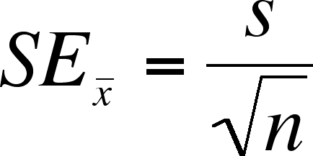
Calculating Standard Error
Using the same data from our Standard Deviation calculation:
Mean = 87
S = 8
n = 10
SE_{X} = 8/ √10
= 2.52
= 2.5
This means the measurements vary by ± 2.5 from the mean
Bozeman video: Standard Error

Slide 17
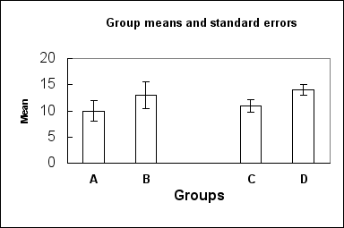
Graphing Standard Error
Common practice to add standard error bars to graphs, marking one standard error above & below the sample mean (see figure below). These give an impression of the precision of estimation of the mean, in each sample.
Which sample mean is a better estimate of its population mean, B or C?
Identify the two populations that are most likely to have statistically significant differences?

