Slide 1
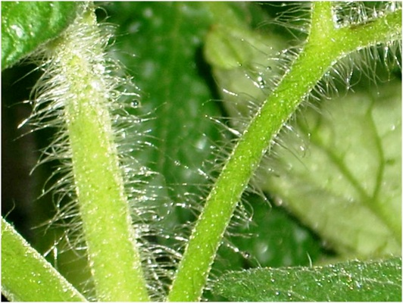
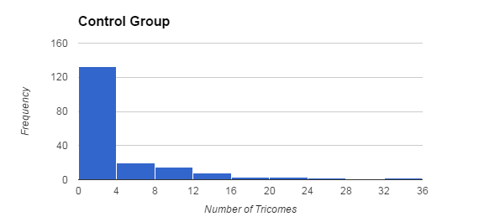
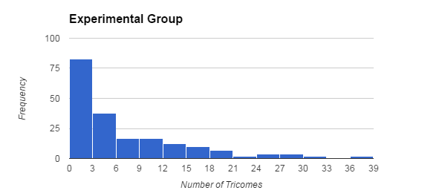
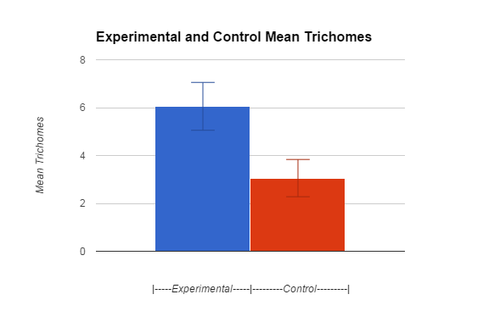
Effect of Selection on Trichome Count
Alexander T. Toney
Sycamore High School, Mr. Smanik AP Biology 5th and 6th Bell 2015
Introduction
Methods
Summary of Results
Trichomes are tiny hair like structures which line the stems and leaves of plants. Trichomes serve many purposes, one of which is protection from predators. These hairs vary in number between different plants, and this variation is believed to be genetic. In this lab, we are seeing the effect that selection has on trichrome count. The selection in this situation is artificial, since humans were the selective force, and the selection was also directional, as the plants with high trichrome count were bred with each other. The independent variable is number of trichomes in the parent generation, and the Dependant variable is the number of trichomes in the next generation.
First we set up the environment in which the seeds would grow. This entailed setting up tubs of water with a cloth to draw water upwards into strings which extended from the bottom of the seed containers. The seed containers had dirt, fertilizer, the seeds, and some light soil on top. We then placed many of these under a sun lamp and waited for them to grow. When the plants had matured, we then counted the number of trichomes by placing the plants against a black background in a well lit area, and only counting the ones on the main stem. After recording this information, as well as which plant was which number, we randomly assigned plants to the control or experimental group. The plants in the control group were randomly pollinated with each other, while the experimental group allowed only the tallest ones to breed with each other. Then we waited for the plants to produce seeds, which we harvested and kept track of. Then, blinded, we repeated the planting process with the new set of seeds. After growing, we repeated the counting process with each person counting the trichomes on a few plants. After placing them in a table, we were able to see which data were for the control, and which were for the experimental. Below are a diagram of the seed holder and a light similar to the one we used.
The mean number of trichomes for the control group was approximately 3, while the mean number of trichomes for the experimental group was approximately 6.
The control group had 178 plants, the experimental had 187
Control standard deviation is 5.19, the experimental standard deviation is 7.31
Control standard error is .389, and two standard errors is .778
Experimental standard error is .534, and two standard errors is 1.06
Using a t confidence interval for means, we can see that within two standard errors the intervals for mean trichrome number do not overlap. This gives us a preliminary result which suggests that there is a statistically significant difference.
Using a two sample t test, the t statistic is calculated to be 4.53
The p value for the null hypothesis of experimental equaling control mean and alternative of the experimental mean being greater is .000004. This p value I'd less than a .05 significance level, which means that the null hypothesis is rejected.
Conclusions
Rejection of the null hypothesis means that the mean number of trichomes is greater for the experimental group, showing that the artificial selection was effective in increasing mean trichrome count. The extremely low p value means that at almost any reasonable significance level the null hypothesis is rejected. This means that it is extremely likely that the number of trichomes is a genetically heritable trait which is passed on through pollination.
Rationale and Hypothesis
If trichrome number is a genetically inherited trait, then selecting for many trichomes will produce offspring with a higher hair count than the control group. The change in mean trichrome count between the control and experimental populations provides evidence for the heritability of trichrome count, and the effectiveness of artficial, directional selection.
In this experiment, the null hypothesis was that the mean trichrome count for the experimental group would be equal to the mean count for the control. This would mean that the selection
did not have an effect on trichrome number, so trichomes are either non-genetic or they are not effected by selection strongly.
The alternative hypothesis is that the mean trichrome count for the experimental group will be higher than the mean trichrome count for the control group. This would mean that not only are trichome numbers heritable, they are also subject to selection.
Results
Below are the histograms for trichrome count for the control and experimental groups, as well as a bar graph with 2 standard error bars on each mean trichrome count.
Extension
This investigation into selection pressures shows that trichrome count can be changed between generations of plants. A situation like this could be used to model natural selection, specifically directional selection, of trichomes in nature. As previously mentioned, trichomes are sometimes used to make consumption of the plant harder. Artificially selecting for high trichrome count could be used to model natural selection in an environment that suddenly changed to have a larger population of herbivores who want to eat the plant.

